Slide 1
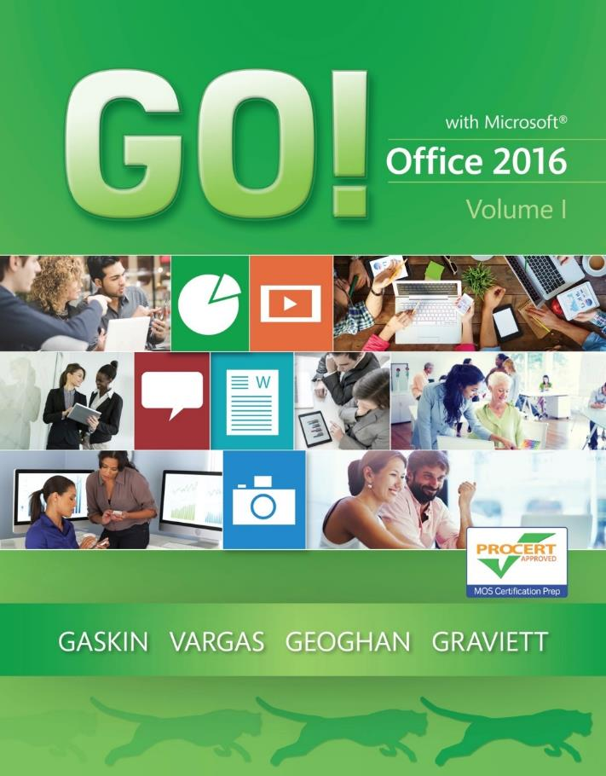
GO! with Microsoft Office 2016
Gaskin Vargas Geoghan Graviett

Slide 2
Word – Chapter 1
Creating Documents with Microsoft Word 2016

Slide 3
Objectives
Create a New Document and Insert Text
Insert and Format Graphics
Insert and Modify Text Boxes and Shapes
Preview and Print a Document
Change Document and Paragraph Layout
Create and Modify Lists
Set and Modify Tab Stops
Insert a SmartArt Graphic and an Online Video
Notes:
In this chapter, you will begin your study of Microsoft Word, one of the most popular computer programs and one that almost everyone has a reason to use. You will use many of the Word 2016 tools, such as applying attractive styles to your documents.

Slide 4
Create a New Document and Insert Text
Notes:
Some of Word 2016’s default settings include:
Calibri, 11 point font
Left, right, top, and bottom margins of 1”
Line spacing of 1.08
Spacing after a paragraph is 8 points
When the Show/Hide button is active, formatting marks display as shown above.

Slide 5
Create a New Document and Insert Text
Notes:
To insert text from a file, use the Text from File option from the Object button arrow as shown here.
A template is a preformatted document that you can use as a starting point and then change to suit your needs.

Slide 6
Insert and Format Graphics
Notes:
Graphics—pictures, online pictures, charts, and drawing objects (shapes, diagrams, lines, etc.)—add visual interest to a document. Word also offers numerous text effects—decorative formats such as shadowed or mirrored text, text glow, 3-D effects, and colors. To remove text effects that have been added to a document, click the Home tab, and in the Font group, click Clear All Formatting.

Slide 7
Insert and Format Graphics
Notes:
You can insert an object in a Word document with the Pictures button on the Insert tab. Word inserts the picture as an inline object, meaning that the picture is positioned directly in the text at the insertion point. Layout Options can be changed to control the manner in which text wraps around an object. A rotation handle can be used to rotate the object to any angle.

Slide 8
Insert and Format Graphics
Notes:
Picture styles include shapes, shadows, frames, borders, and other special effects. Picture Effects enhance a picture with effects such as a shadow, glow, reflection, or 3-D rotation.

Slide 9
Insert and Format Graphics
Notes:
Page borders frame a page and help to focus the information on the page. Click the Design tab, and in the Page Background group, click Page Borders. The Borders and Shading dialog box allows you to set the border style and the color.

Slide 10
Insert and Modify Text Boxes and Shapes
Notes:
Word 2016 offers many predefined shapes—an object such as a line, arrow, box, callout, or banner. The Shapes gallery is accessible by clicking the Insert tab, and then in the Illustrations group, click Shapes. Text can be typed in a shape or the shape can be left empty.

Slide 11
Insert and Modify Text Boxes and Shapes
Notes:
A text box is a movable, resizable container for text or graphics. It is often helpful to differentiate portions of text from other text on the page. A text box is a floating object—a graphic that can be moved independently of the surrounding text characters. A text box can be placed anywhere on a page. A shape style can also be added to a text box.

Slide 12
Preview and Print a Document
Notes:
Information in headers and footers can identify a document when it is printed or displayed on the screen. A header is information that prints at the top of every page; a footer is information that prints at the bottom of every page. The document file name, for example, can be inserted into a footer by clicking the Design tab, clicking Document Info from the Insert group, and then clicking File Name.

Slide 13
Preview and Print a Document
Notes:
Tags are a document property that help identify a file and can be added in Backstage view in the list of properties.
The Print Preview option in Word allows you to view a document prior to printing it. Print Preview displays your document exactly as it will print; the formatting marks do not display. You can move between pages with the arrows below the page display. Click the Print button when you are ready to print the document.

Slide 14
Change Document and Paragraph Layout
Notes:
Margins are the space between the text and the top, bottom, left, and right edge of the paper. Paragraph layout includes line spacing, indents, and tabs.

Slide 15
Change Document and Paragraph Layout
Notes:
Alignment is the placement of paragraph text relative to the left and right margins. Most paragraph text uses left alignment—aligned at the left margin, leaving the right margin uneven. The three other alignments are:
Center alignment—centered between the left and right margins
Right alignment—aligned at the right margin with an uneven left margin
Justified alignment—text aligned evenly at both the left and right margins

Slide 16
Change Document and Paragraph Layout
Notes:
Line spacing is the distance between lines of text in a paragraph. Three of the most common line spacing formats are shown here in the table. The Line and Paragraph Spacing button is on the Home tab.

Slide 17
Change Document and Paragraph Layout
Notes:
It is common to indent the first line of each paragraph in a document. This can be done in the Paragraph dialog box, accessible from the Dialog Box Launcher in the Paragraph group on the Home tab.

Slide 18
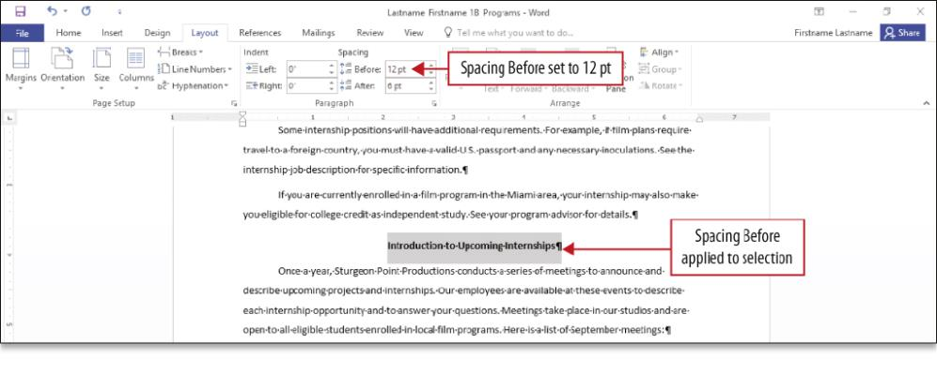
Change Document and Paragraph Layout
Notes:
You can also differentiate paragraphs by adding space after each paragraph. On either the Home tab or the Layout tab, display the Paragraph dialog box from the Paragraph group, and then under Spacing, click the spin box arrows as necessary.

Slide 19
Create and Modify Lists
Notes:
To display a list of information, a bulleted list or a numbered list is helpful. A bulleted list uses bullets—text symbols such as small circles or check marks—to introduce each item in the list. If items can be listed in any order, a bulleted list should be used.

Slide 20
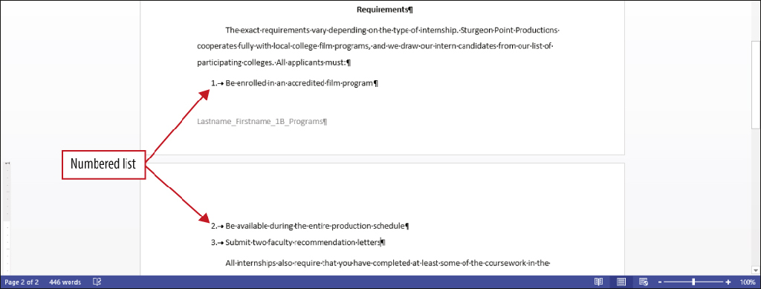
Create and Modify Lists
Notes:
A numbered list uses consecutive numbers of letters to introduce each item in the list. Use a numbered list for items that have definite steps, a sequence of actions, or are in chronological order. The First Line Indent marker on the ruler indicates the indent location in the document.

Slide 21
Create and Modify Lists
Notes:
You can also customize the bullets that display in your document. When bullet text is selected, the Bullets button arrow displays on the mini toolbar. Choose a new bullet from the Bullet Library.
When a list is complete, press the Backspace key, click the Numbering or Bullets button, or press Enter two times to turn numbering or bullets off. The Bullets and the Numbering buttons are toggle buttons—clicking the button one time turns the feature on, and clicking the button again turns the feature off.

Slide 22
Set and Modify Tab Stops
Notes:
Tab stops mark specific locations on a line of text. Tab stops are used to indent and align text in a document. Use the Tab key to move to tab stops in the document.

Slide 23
Set and Modify Tab Stops
Notes:
There are seven types of tab alignment options shown here in the table. Each has its specific purpose to enhance your document.

Slide 24
Set and Modify Tab Stops
Notes:
The Tab dialog box allows you to easily change tab stop locations in a document. The Tab dialog box also allows you to create a dot leader—a series of dots that display between columns of a list—in a document. A leader character creates a solid, dotted, or dashed line that fills the space to the left of a tab character and draws the reader’s eyes across the page from one item to the next.

Slide 25
Set and Modify Tab Stops
Notes:
This document shows dot leaders in a tabbed list.

Slide 26
Insert a SmartArt Graphic and an Online Video
Notes:
SmartArt graphics are designer-quality visual representations of information. Word 2016 provides many different layout options that should suit every purpose.

Slide 27
Insert a SmartArt Graphic and an Online Video
Notes:
The SmartArt Tools Design tab offers options to change the colors of a SmartArt graphic as well as the style. This SmartArt graphic has had Colorful Range – Accent Colors 4 to 5 and Inset style applied.

Slide 28
Insert a SmartArt Graphic and an Online Video
Notes:
You can search the web for an online video, search YouTube, or enter an embed code to insert a link to a video from a website. An embed code is a code that creates a link to a video, picture, or other type of rich media content. Rich media, also called interactive media, refers to computer interaction that responds to your actions; for example, by presenting text, graphics, animation, video, audio, or games.

Slide 29
Questions ?

Slide 30
Copyright
All rights reserved. No part of this publication may be reproduced, stored in a retrieval system, or transmitted, in any form or by any means, electronic, mechanical, photocopying, recording, or otherwise, without the prior written permission of the publisher. Printed in the United States of America.

