Slide 1
GO! with Microsoft Office 2016
Gaskin Vargas Geoghan Graviett

Slide 2
PowerPoint – Chapter 1
Getting Started with Microsoft PowerPoint

Slide 3
Objectives
Create a New Presentation
Edit a Presentation in Normal View
Add Pictures to a Presentation
Print and View a Presentation
Edit an Existing Presentation
Format a Presentation
Use Slide Sorter View
Apply Slide Transitions
Notes:
Good presentation skills enhance your communication. Technology like PowerPoint can greatly add to a presentation that you offer. Microsoft PowerPoint 2016 is presentation software with which you create electronic slide presentations. Use PowerPoint to present information to your audience effectively. You can start with a new, blank presentation and add content, pictures, and themes.

Slide 4
Create a New Presentation
Notes:
When you start PowerPoint, you can select a blank presentation or a theme—a set of unified design elements that provides a look for your presentation by applying colors, fonts, and effects. A presentation consists of one or more slides—similar to a page in a document that contains text, pictures, tables, charts, or other multimedia or graphic objects. The Facet theme is shown here.

Slide 5
Create a New Presentation
Notes:
The PowerPoint window displays in Normal view, which is the primary editing view in PowerPoint. You see a thumbnail—a miniature image—in the left pane and the Slide pane displays a larger image of the active slide.

Slide 6
Create a New Presentation
Notes:
Many of the PowerPoint screen elements are shown here in this table. Being familiar with the parts of the PowerPoint window will help you become efficient in using PowerPoint.

Slide 7
Create a New Presentation
Notes:
A placeholder is a box on a slide with dotted or dashed borders that holds title and body text, charts, tables, and pictures. The title slide is usually the first slide in a presentation, as shown here.

Slide 8
Create a New Presentation
Notes:
A theme is a set of unified design elements that provides a look for your presentation by applying colors, fonts, and effects. A theme can be added when a presentation is created or added or changed at any time. Themes display in the Themes gallery as shown here.

Slide 9
Edit a Presentation in Normal View
Notes:
When you insert a new slide into a presentation, it has a particular layout—the arrangement of elements, such as title and subtitle text, lists, pictures, tables, charts, shapes, and movies—on a slide. The New Slide button, a split button—a two part button on the ribbon—inserts a slide automatically from the top half of the button and opens the Layout gallery from the lower half of the button.

Slide 10
Edit a Presentation in Normal View
Notes:
Text is often organized on PowerPoint slides in list levels. List levels, each represented by a bullet symbol, are similar to outline levels. On a slide, list levels are identified by the bullet style, indentation, and the size of the text. The first level on an individual style is the title. Use the Tab key and Shift + Tab to indent to the next level and decrease the indent level, respectively.

Slide 11
Edit a Presentation in Normal View
Notes:
The Notes pane is an area of the Normal view window that displays below the Slide pane with space to type notes regarding the current slide. The Notes pane is typically used for notes that the speaker wants to mention while making a presentation but not necessarily information that you want displayed for the audience. An example is shown here.

Slide 12
Edit a Presentation in Normal View
Notes:
ScreenTips are very helpful in PowerPoint. In the first image on this slide, you see the ScreenTip with the slide number and slide name when using the scroll box on the vertical scroll bar. A ScreenTip of the title of the slide appears in the left pane when you point to a slide, as shown by the second image.

Slide 13
Edit a Presentation in Normal View
Notes:
A section header is a slide layout that looks slightly different than most other slides in a presentation with the intent of signaling a slight change of theme or topic. Section header slides do not contain bullets.
The AutoFit Text to Placeholder options keeps the text contained with a placeholder by reducing the size of the text.

Slide 14
Add Pictures to a Presentation
Notes:
Many slide layouts have a placeholder within which to insert a picture, but pictures can also be inserted directly onto a slide with the Insert tab. The image on this slide was inserted into a placeholder by clicking the Pictures icon. When a picture is inserted and selected, sizing handles—small circles that indicate that it is selected and can be edited or moved—display. A rotation handle displays at the top.

Slide 15
Add Pictures to a Presentation
Notes:
A style is a collection of formatting options that you can apply to a picture, text, or an object. When you select a picture, the Picture Tools Format tab displays on the ribbon. The Format tab provides numerous styles to apply to your pictures. The Picture Styles gallery, as shown here, is accessed from the More button in the Picture Styles group.

Slide 16
Add Pictures to a Presentation
Notes:
Artistic effects are formats applied to images that make pictures resemble sketches or paintings. The Artistic Effects gallery is shown here.

Slide 17
Print and View a Presentation
Notes:
Pressing F5 is a quick way to start the slide show from the beginning. You can also display the first slide you want to show and click the Slide Show button on the lower right side of the status bar. When you’re running a slide show, press the Spacebar or click the left mouse button to advance the slides. At the end of the slide show, a black slide displays indicating that the show is over.

Slide 18
Print and View a Presentation
Notes:
Presenter View shows the full-screen slide show on one monitor or projection screen for the audience to see, while enabling the presenter to view a preview of the next slide, notes, and a timer on another monitor.

Slide 19
Print and View a Presentation
Notes:
The Header and Footer dialog box—accessed from the Insert tab, Text group, and the Header & Footer button—enables you to insert a header and/or a footer.

Slide 20
Print and View a Presentation
Header
Text that prints at the top of each sheet of slide handouts or notes pages
Footer
Text that displays at the bottom of every slide or that prints at the bottom of a sheet of slide handouts or notes pages
Slide handouts
Printed images of slides on a sheet of paper
Notes pages
Printouts that contain the slide image on the top half and notes from the Notes pane in the lower half of a page

Slide 21
Print and View a Presentation
Notes:
There are several print options in PowerPoint 2016. For example, you can print full page images of slides, presentation handouts for your audience with copies of slides, or Notes pages that include speaker notes below an image of the slide. Review the different print options from the image shown here.

Slide 22
Edit an Existing Presentation
Notes:
Presentations created with one of the themes in PowerPoint 2016 default to a widescreen format using a 16:9 aspect ratio—the ratio of the width of a display to the height of the display. This slide size is similar to most television and computer monitor screens. PowerPoint 2010 and earlier versions used a squarer format with a 4:3 aspect ratio. The widescreen format utilizes screen space more effectively.

Slide 23
Edit an Existing Presentation
Notes:
It is not always necessary to create new content for slides. If content exists in another presentation, you can insert one or more slides into your current presentation through the Reuse Slides pane shown here. When the Keep source formatting check box is checked, original formatting is retained; when it is cleared, the current theme formatting inserted is applied.

Slide 24
Edit an Existing Presentation
Notes:
Outline View displays the presentation outline to the left of the Slide pane and can be used to easily edit presentation text. Each slide in the outline displays the slide number, slide icon, and the slide title in bold. Slides that do not display a slide title in the outline use a slide layout that does not include a title; for example, the Blank layout.

Slide 25
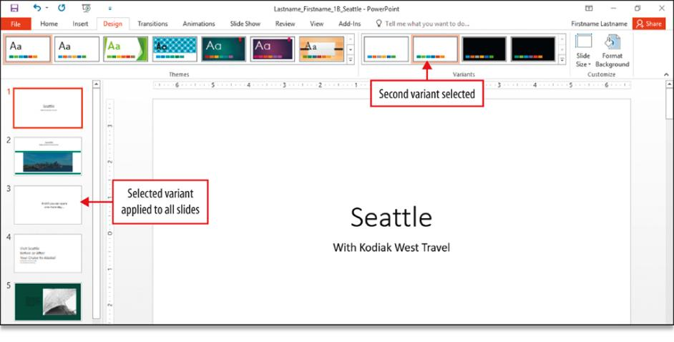
Format a Presentation
Notes:
Formatting refers to changing the appearance of the text, layout, and design of a slide. Changing the variant—variations on the theme style and color—of the theme is one formatting option available in PowerPoint.

Slide 26
Format a Presentation
Notes:
Font styles and font color are useful to provide emphasis and are a visual cue to draw the reader’s eye to important text. Text alignment refers to the horizontal placement of text within a placeholder. You can align text left, centered, right, or justified.

Slide 27
Use Slide Sorter View
Notes:
Slide Sorter view displays thumbnails of all of the slides in a presentation. Slide Sorter view is helpful in arranging and deleting slides and to apply formatting to multiple slides. Contiguous slides are slides that are adjacent to each other in a presentation. Noncontiguous slides are slides that are not adjacent to each other in a presentation.

Slide 28
Apply Slide Transitions
Notes:
Slide transitions are the motion effects that occur in Slide Show view when you move from one slide to the next during a presentation. You can apply a transition to one, several, or all slides. Various effect options are also available; they differ depending on the selected transition. Timing and how slides advance can also be set for transitions.

Slide 29
Apply Slide Transitions
Notes:
The Reading view, as shown on this slide, displays a presentation in a manner similar to a slide show but the taskbar, title bar, and status bar remain available in the presentation window. Thus, a presenter can easily facilitate an online conference by switching to another window without closing the slide show. This view can be used to present online.

Slide 30
Questions ?

Slide 31
Copyright
All rights reserved. No part of this publication may be reproduced, stored in a retrieval system, or transmitted, in any form or by any means, electronic, mechanical, photocopying, recording, or otherwise, without the prior written permission of the publisher. Printed in the United States of America.

