Slide 1
GO! with Microsoft Office 2016
Gaskin Vargas Geoghan Graviett

Slide 2
Excel – Chapter 2
Using Functions, Creating Tables, and Managing Large Workbooks

Slide 3
Objectives
Use Flash Fill and the SUM, AVERAGE, MEDIAN, MIN, and MAX Functions
Move Data, Resolve Error Messages, and Rotate Text
Use COUNTIF and IF Functions and Apply Conditional Formatting
Use Date & Time Functions and Freeze Panes
Create, Sort, and Filter an Excel Table
View, Format, and Print a Large Worksheet
Notes:
Excel’s statistical functions are useful for common calculations that you probably encounter frequently. Statistical functions help you to calculate information in worksheets.

Slide 4
Objectives
Navigate a Workbook and Rename Worksheets
Enter Dates, Clear Contents, and Clear Formats
Copy and Paste by Using the Paste Options Gallery
Edit and Format Multiple Worksheets at the Same Time
Create a Summary Sheet with Column Sparklines
Format and Print Multiple Worksheets in a Workbook

Slide 5
Use Flash Fill and the SUM, AVERAGE, MEDIAN, MIN, and MAX Functions
Notes:
Flash Fill recognizes a pattern in your data, and then automatically fills in values when you enter examples of the output that you want. A function is a predefined formula. Statistical functions include AVERAGE, MEDIAN, MIN, and MAX functions.

Slide 6
Use Flash Fill and the SUM, AVERAGE, MEDIAN, MIN, and MAX Functions
Notes:
The SUM function is a predefined formula that adds all the numbers in a selected range of cells. You can insert the SUM function from the Home tab, from the Formulas tab, or by using the keyboard shortcut, Alt + =.

Slide 7
Use Flash Fill and the SUM, AVERAGE, MEDIAN, MIN, and MAX Functions
Notes:
The More Functions button on the Formulas tab offers many function options, including the AVERAGE function, as shown here. The AVERAGE function adds a group of values, and then divides the result by the number of values in the group.

Slide 8
Use Flash Fill and the SUM, AVERAGE, MEDIAN, MIN, and MAX Functions
Notes:
The Function Arguments dialog box allows you to enter the arguments for the function. The AVERAGE function, as shown here, needs a range of cells entered.

Slide 9
Use Flash Fill and the SUM, AVERAGE, MEDIAN, MIN, and MAX Functions
Notes:
The MEDIAN function is a statistical function that describes a group of data; it finds the middle value that has as many values above it in the group as are below it. Defining the arguments—indicating which cells you want to use in the function’s calculation—is done in the Function Arguments dialog box.

Slide 10
Use Flash Fill and the SUM, AVERAGE, MEDIAN, MIN, and MAX Functions
Notes:
The MIN function determines the smallest value in a selected range of values. The statistical MAX function determines the largest value in a selected range of values.

Slide 11
Move Data, Resolve Error Messages, and Rotate Text
Notes:
When you move a formula, the cell references within the formula do not change, no matter what type of cell reference you use. If you move cells that are not wide enough to display number values, a message is displayed so you can adjust as necessary. If a cell width is too narrow to display the entire number, Excel displays the #### message.

Slide 12
Move Data, Resolve Error Messages, and Rotate Text
Notes:
Text can be rotated in a worksheet. In this example, in cell c6, the font size and color was changed and bold and italic were added. Range C4:C8 was merged and then rotated in the Format Cells dialog box, which is accessed from the shortcut menu.

Slide 13
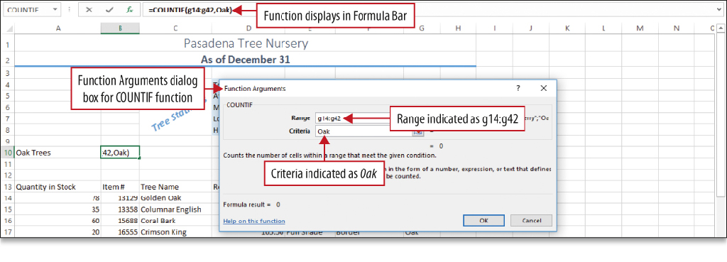
Use COUNTIF and IF Functions and Apply Conditional Formatting
COUNT function
Counts the number of cells in a range that contain numbers
IF function
Uses a logical test to check whether a condition is met
Then returns one value if true, and another value if false

Slide 14
Use Date & Time Functions and Freeze Panes
Notes:
Excel can obtain the date and time from your computer’s calendar and clock, and display this information on your worksheet. The NOW function retrieves the date and time from your computer’s calendar and clock and inserts the information into the selected cell.

Slide 15
Use Date & Time Functions and Freeze Panes
Notes:
The Freeze Panes command enables you to select one or more rows or columns and then freeze or lock them into place. A pane is a portion of a worksheet window bounded by and separated from other portions by vertical or horizontal bars.

Slide 16
Create, Sort, and Filter an Excel Table
Notes:
In order to analyze a group of related data, you can convert a range of cells to an Excel table. An Excel table has a series of rows and columns that contains related data that is managed independently from the data in other rows and columns in the worksheet. A table can have a style applied as shown in this worksheet.

Slide 17
Create, Sort, and Filter an Excel Table
Notes:
You can sort tables—arrange all the data in a specific order—in ascending or descending order.

Slide 18
Create, Sort, and Filter an Excel Table
Notes:
You can also filter tables—display only a portion of the data based on matching a specific value—to show only the data that meets the criteria that you specify. When you are finished answering questions about the data, you can clear the filter.

Slide 19
View, Format, and Print a Large Worksheet
Notes:
You can magnify or shrink the view of a worksheet on your screen to either zoom in or zoom out. You can also split a worksheet window into panes. If a worksheet is too wide, too long, or both, to print on one page, Excel’s Print Title and Scale to Fit commands can help you create pages that are attractive and easy to read. As you can see above, vertical and horizontal split bars display when you split a window.

Slide 20
View, Format, and Print a Large Worksheet
Notes:
Print settings that help you print a professional-looking, large worksheet include:
Center on page command
Landscape orientation
Fil All Columns on One Page command
Print Titles command

Slide 21
Navigate a Workbook and Rename Worksheets
Notes:
Sheet tabs identify each worksheet in a workbook and display along the lower left edge of the workbook window. Sheet tab colors can also be changed.

Slide 22
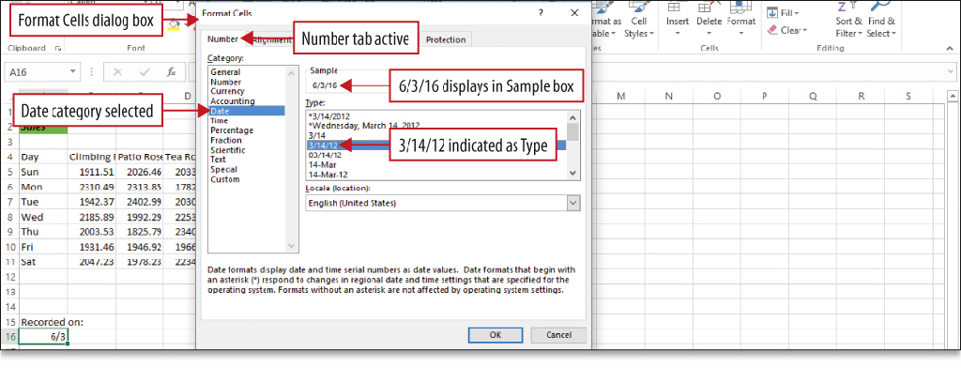
Enter Dates, Clear Contents, and Clear Formats
Notes:
Dates represent a type of value that you can enter in a cell. When you enter a date, Excel assigns a serial value—a number—to the date. This makes it possible to treat dates like other numbers and use them in calculations.

Slide 23
Copy and Paste by Using the Paste Options Gallery
Notes:
Data in cells can be copied to other cells. When you paste data to another cell, the Paste Options gallery displays, which includes Live Preview to preview the Paste formatting that you want.

Slide 24
Edit and Format Multiple Worksheets at the Same Time
Notes:
You can enter or edit data on several worksheets at the same time. Use the Ctrl key to select more than one worksheet tab. If the sheet tab displays with a solid background color, you know the sheet is not selected. If you see [Group] in the title bar and tab names are underlined, those sheets have been grouped.

Slide 25
Edit and Format Multiple Worksheets at the Same Time
Notes:
Formulas, formatting, and styles in this workbook were applied to several worksheets at the same time by grouping the sheets.

Slide 26
Create a Summary Sheet with Column Sparklines
Notes:
A summary sheet is a worksheet where totals from other worksheets are displayed and summarized. This summary sheet uses formulas constructed from other sheets in the workbook, known as the detail sheets. This summary sheet also contains sparklines—tiny charts within a single cell that show a data trend.

Slide 27
Format and Print Multiple Worksheets in a Workbook
Notes:
You can drag a worksheet to a new location. This summary sheet was moved to be the first worksheet in the workbook.

Slide 28
Format and Print Multiple Worksheets in a Workbook
Notes:
By selecting more than one worksheet, you can apply the same formatting to all the worksheets at the same time, for example, to repeat headers or footers. You can also group worksheets in order to print several sheets at one time. In Print Preview, the number of pages that will print is indicated at the bottom of the window, as shown here.

Slide 29
Questions ?

Slide 30
Copyright
All rights reserved. No part of this publication may be reproduced, stored in a retrieval system, or transmitted, in any form or by any means, electronic, mechanical, photocopying, recording, or otherwise, without the prior written permission of the publisher. Printed in the United States of America.

