Slide 1
GO! with Microsoft Office 2016
Gaskin Vargas Geoghan Graviett

Slide 2
Excel – Chapter 1
Creating a Worksheet and Charting Data

Slide 3
Objectives
Create, Save, and Navigate an Excel Workbook
Enter Data in a Worksheet
Construct and Copy Formulas and Use the SUM Function
Format Cells with Merge & Center, Cell Styles, and Themes
Chart Data to Create a Column Chart and Insert Sparklines
Print a Worksheet, Display Formulas, and Close Excel
Check Spelling in a Worksheet
Enter Data by Range
Construct Formulas for Mathematical Operations
Edit Values in a Worksheet
Format a Worksheet
Notes:
Excel 2016 is a tool to communicate quantitative business information effectively. According to Stephen Few, in his book Show Me the Numbers, “Quantitative information forms the core of what businesses must know to operate effectively.” Rather than just a tool for making calculations, Excel is now a tool for you to communicate and collaborate with others. Tables and graphs help with this.

Slide 4
Create, Save, and Navigate an Excel Workbook
Notes:
When you start Excel, a new blank workbook—the Excel document that stores your data—displays. A workbook contains one or more pages called a worksheet (also known as a spreadsheet). Worksheets are stored in a workbook and formatted as a pattern of uniformly spaced horizontal rows and vertical columns, the intersection of which is referred to as a cell.

Slide 5
Create, Save, and Navigate an Excel Workbook
Notes:
A column is a vertical group of cells in a worksheet. Each column heading is designated in alphabetical order—A, B, C, etc. This is the column heading. After column Z, columns start with AA, AB, and so on. A row is a horizontal group of cells. Row headings are designated by a unique number—1, 2, 3, etc. A single worksheet can have 1,04,576 rows of data.

Slide 6
Enter Data in a Worksheet
Notes:
Cell content, anything that you type in a cell, can be a constant value (referred to simply as a value) or a formula. A formula is an equation that performs mathematical calculations on values in your worksheet. The most commonly used values are text values and number values. A text value is also referred to as a label. A cell reference is the intersection column letter and row number.

Slide 7
Enter Data in a Worksheet
Notes:
The fill handle is a small square in the lower right corner of a selected cell. You can drag the fill hand to adjacent cells to fill the cells with values based on the first cell. Auto Fill generates and extends a series of values into adjacent cells based on the value of other cells. The Auto Fill Options button displays options to fill the data.

Slide 8
Enter Data in a Worksheet
Notes:
Keyboard shortcuts can help you navigate a worksheet more efficiently.

Slide 9
Enter Data in a Worksheet
Notes:
A range is two or more cells on a worksheet that are adjacent or nonadjacent. When you see a colon between two cell references, the range includes all the cells between the two cell references.
The Quick Analysis tool displays in the lower right corner of the selected range, with which you can analyze your data by using Excel tools such as charts, color-coding, and formulas.

Slide 10
Enter Data in a Worksheet
Notes:
Data that displays in a cell is the displayed value. Data that displays in the Formula Bar is the underlying value. The number of digits or characters that display in a cell—the displayed value—depends on the width of the column. Calculations on numbers will always be based on the underlying value, not on the displayed value.

Slide 11
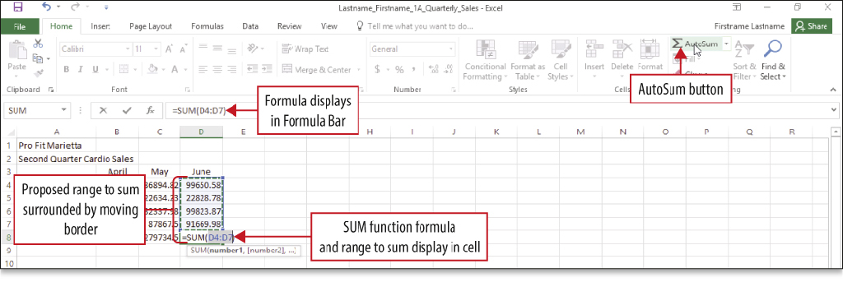
Construct and Copy Formulas and Use the SUM Function
Notes:
A formula is an equation that performs mathematical calculations on values in other cells, and then places the result in the cell containing the formula. You can create formulas or use a function—a prewritten formula that looks at one or more values, performs an operation, and then returns a value.

Slide 12
Construct and Copy Formulas and Use the SUM Function
Notes:
The SUM function is an Excel function—a prewritten formula. In the SUM function show above, the = sign signals the beginning of a formula or function, SUM indicates the type of calculation, and the (D4:D7) indicates the range of cells on which the sum calculation will be performed.

Slide 13
Format Calls with Merge & Center, Cell Styles, and Themes
Notes:
A cell style is a defined set of formatting characteristics, such as font, font size, font color, cell borders, and cell shading.
The Merge & Center command joins selected cells into one larger cell and centers the contents in the merged cell.

Slide 14
Format Calls with Merge & Center, Cell Styles, and Themes
Notes:
When number values are typed into a cell, by default, they align at the right edge of the cell. The default number format—a specific way in which Excel displays numbers—is the general format. The Accounting Number Format, as shown on this slide, applies a thousand comma separator where appropriate, inserts a fixed U.S. dollar sign aligned at the left edge of the cell, applies two decimal places, and leaves a small amount of space at the right edge of the cell to accommodate a parenthesis when negative numbers are present.

Slide 15
Format Calls with Merge & Center, Cell Styles, and Themes
Notes:
The Comma Style inserts a thousand comma separator where appropriate and applies two decimal places.
A theme is a predefined set of colors, fonts, lines, and fill effects that coordinate for an attractive look.

Slide 16
Chart Data to Create a Column Chart and Insert Sparklines
Notes:
A chart is a graphic representation of data in a worksheet. Data in a chart is easier to understand than a table of numbers. Recommended Charts is an Excel feature that displays a customized set of charts that, according to Excel’s calculations, will best fit your data. A column chart is useful for illustrating comparisons among related numbers.

Slide 17
Chart Data to Create a Column Chart and Insert Sparklines
Notes:
When a chart has been created and inserted, and is selected, border and sizing handles display. Contextual tools named Chart Tools display and add contextual tabs next to the standard tabs on the ribbon. In this example, a clustered column chart has been inserted into the worksheet and is selected.

Slide 18
Chart Data to Create a Column Chart and Insert Sparklines
Notes:
When a chart is selected, three button display to the right of the chart:
The Chart Elements button enables you to add, remove, or change chart elements such as the title, legend, gridlines, and data labels.
The Chart Styles button enables you to set a style or color scheme for your chart.
The Chart Filters button enables you to change which data displays in the chart.

Slide 19
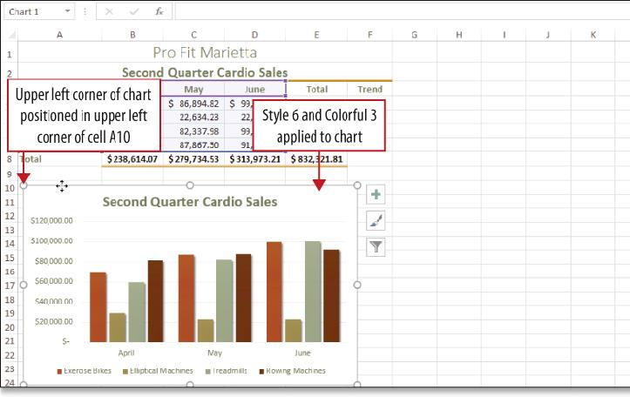
Chart Data to Create a Column Chart and Insert Sparklines
Notes:
The Chart Styles gallery displays an array of predefined chart styles—the overall visual look of a chart in terms of its colors, backgrounds, and graphic effects. The Style gallery and the Color gallery are available from the Chart Styles button.

Slide 20
Chart Data to Create a Column Chart and Insert Sparklines
Notes:
Sparklines are tiny charts embedded in a cell that give a visual trend summary alongside your data. A sparkline makes a pattern more obvious to the eye. By creating sparklines, you provide a context for your numbers. Your readers will be able to see the relationship between a sparkline and its underlying data quickly.

Slide 21
Print a Worksheet, Display Formulas, and Close Excel
Notes:
Use the Show Formulas command to display the formula in each cell instead of the resulting value. Then you can use the commands on the page Layout tab to prepare for printing. The Page Setup dialog box allows you to select printing options prior to printing your document.

Slide 22
Print a Worksheet, Display Formulas, and Close Excel
Notes:
Always pay attention to the Print Preview of a worksheet so you know how your document will print prior to sending it to the printer.

Slide 23
Check Spelling in a Worksheet
Notes:
In Excel, the spelling checker performs similarly to the other Microsoft Office programs. Start in cell A1 since the spelling checker searches from top to bottom, and click Spelling on the Review tab or press F7.

Slide 24
Enter Data by Range
Notes:
Since data entry can be time consuming, there is a time-saving technique in Excel. You first select the range of cells, and then you enter the data. After you enter the last value and press Enter, the active cell moves to the top of the next column within the selected range. Data entry in this manner is not required, but it can save you a lot of time because it confines the movement of the active cell to the selected range.

Slide 25
Construct Formulas for Mathematical Operations
Notes:
Operators are symbols with which you can specify the type of calculation you want to perform in a formula.

Slide 26
Construct Formulas for Mathematical Operations
Notes:
The Quick Analysis button displays when you select a range of data; it displays common commands. On this slide, the shaded cells on the button indicate what will be summed and where the result will display, and a preview of the result displays in the cell bordered with a gray shadow.

Slide 27
Construct Formulas for Mathematical Operations
Notes:
A relative cell reference refers to a cell by its position relative to the cell that contains the formula. An absolute cell reference, on the other hand, refers to a cell by its fixed position in the worksheet. A relative cell reference automatically adjusts when a formula is copied, but in some calculations, you need a cell reference to remain fixed when copied. The $ in the formulas in this slide indicate absolute.

Slide 28
Edit Values in a Worksheet
Notes:
Excel formulas recalculate if you change the value in a cell that is referenced in this formula. Simply start typing the new value and it will replace the old value, and the formula will recalculate automatically. If text is too long to fit in a cell and the cell to the right contains data, the text is truncated—cut off—but the entire value still exists as the underlying value.

Slide 29
Format a Worksheet
Notes:
Formatting refers to the process of specifying the appearance of cells and the overall layout of your worksheet. Columns and rows can be added and/or deleted, column widths can be adjusted, headings can be wrapped in cells, alignment can be changed, colors and styles can be changed, and headers or footers can be added. Many of these enhancements have been made to the worksheet on this slide shown in Print Preview.

Slide 30
Questions ?

Slide 31
Copyright
All rights reserved. No part of this publication may be reproduced, stored in a retrieval system, or transmitted, in any form or by any means, electronic, mechanical, photocopying, recording, or otherwise, without the prior written permission of the publisher. Printed in the United States of America.

