Slide 1
GO! with Microsoft Office 2016
Gaskin Vargas Geoghan Graviett

Slide 2
Word– Chapter 3
Creating Research Papers, Newsletters, and Merged Mailing Labels

Slide 3
Objectives
Create a Research Paper
Insert Footnotes in a Research Paper
Create Citations and a Bibliography in a Research Paper
Use Read Mode and PDF Reflow
Format a Multiple-Column Newsletter
Use Special Character and Paragraph Formatting
Create Mailing Labels Using Mail Merge
Notes:
Word 2016 offers many tools for creating complex documents. Word has tools that enable you to create a research paper that includes citations, footnotes, and a bibliography. Multiple-column newsletters can also be created and formatted with Word tools.

Slide 4
Create a Research Paper
The two most commonly used styles for research papers are those created by the:
Modern Language Association (MLA)
American Psychological Association (APA)
Notes:
Standard style guides—a manual that contains standards for the design and writing of documents—for research papers include Modern Language Association (MLA), American Psychological Association (APA), and several others.

Slide 5
Create a Research Paper
Notes:
An MLA paper, as shown here, uses 1-inch margins, a 0.5” first line indent, and double spacing throughout the body of the document, with no extra space above or below paragraphs. On the first page of an MLA-style research paper, on the first line, is the report author. The second line contains the person for whom the report is prepared. The third line is the class or business, the fourth, the date, and the fifth, the report titled, centered.

Slide 6
Create a Research Paper
Notes:
The author’s last name and automatic page numbering should be in the header.

Slide 7
Create a Research Paper
Notes:
MLA style uses 0.5-inch indents at the beginning of the first line of every paragraph. Indenting—moving the beginning of the first line of a paragraph to the right or left of the rest of the paragraph—provides visual cues to the reader to help divide the document text and make it easier to read.

Slide 8
Insert Footnotes in a Research Paper
Notes:
A footnote is a note placed at the bottom of the page containing the note. Endnotes are notes placed at the end of a document or chapter. A footnote is shown on this slide with default formatting and a short solid, black line that separates the body of the report from the footnote. When you insert a new footnote, all remaining footnotes are automatically renumbered.

Slide 9
Insert Footnotes in a Research Paper
Notes:
Word contains built-in paragraph formats called styles—groups of formatting commands, such as font, font size, font color, paragraph alignment, and line spacing—that can be applied to a paragraph with one command. The default style for footnote text is single-spacing, 10-point Calibri font, and no paragraph indents. Word offers symbols, as well, instead of using numbers to designate footnotes.

Slide 10
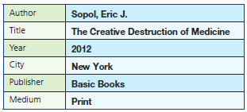
Create Citations and a Bibliography in a Research Paper
Notes:
When you use quotations from or detailed summaries of other people’s work, you must specify the source of the information. A citation is a note inserted into the text of a report or research paper that refers the reader to a source in the bibliography. A bibliography at the end of a research paper lists the sources you have referenced. Such a list is typically titled Works Cited (MLA), Bibliography, Sources, or References.

Slide 11
Create Citations and a Bibliography in a Research Paper
Notes:
A parenthetical reference is a reference that includes the last name of the author or authors and the page number (if available) in the references source, which you add to the reference. No year is indicated, and there is no comma between the name and the page number. Most Website citations, as shown on this slide, do not include a page number.

Slide 12
Create Citations and a Bibliography in a Research Paper
Notes:
A bibliography includes a list of each source referenced in a report or research paper. This bibliography page must start on a new page. Ctrl + Enter inserts a manual page break—the forcing of a new page. The page heading for an MLA Style report is Works Cited; for Business Style, Bibliography; for APA Style, References. Note the hanging indent—the first line of each entry extends .5 inches to the left of the remaining lines of the entry.

Slide 13
Create Citations and a Bibliography in a Research Paper
Notes:
The Navigation pane makes it easy to move to a specific page or to find specific objects in a document. To use the Go To command, use the Home tab and click Go To from the Find arrow or hold down Ctrl and press G.

Slide 14
Create Citations and a Bibliography in a Research Paper
Notes:
For a research paper, you may want to add additional document properties. In the Advanced Properties dialog box, you can view and modify additional document properties as shown here.

Slide 15
Use Read Mode and PDF Reflow
Notes:
Read Mode optimizes the view of the Word screen for the times when you are reading Word document on the screen and not creating or editing them. On the View tab, in the Views group, click Read Mode. Read Mode keeps footnotes displayed on the page associated with the footnote.

Slide 16
Use Read Mode and PDF Reflow
Notes:
PDF Reflow provides the ability to import PDF files into Word so that you can transform a PDF back into a fully editable Word document. If you do not have the Word document that you used to create a PDF, this feature can be very helpful.

Slide 17
Format a Multiple-Column Newsletter
Notes:
A newsletter is a periodical that communicates news and information to a specific group. Newsletters often have two or more columns. A manual column break is an artificial end to a column to balance the columns or to provide space for the insertion of other objects. A section is a portion of a document that can be formatted differently from the rest of the document.

Slide 18
Format a Multiple-Column Newsletter
Notes:
Justified text is sometimes preferred in document text with two or more columns. It is often considered easier to read than having an uneven right margin.

Slide 19
Format a Multiple-Column Newsletter
Notes:
A column break indicator is a dotted line containing the words Column Break that displays at the bottom of a column.

Slide 20
Format a Multiple-Column Newsletter
Notes:
Images can enhance a newsletter. On the Insert tab, in the Illustrations group, click Online Pictures. Type one or more keywords into the Bing Image Search box to locate appropriate images for your document. The result indicates the images are licensed under Creative Commons, a “nonprofit organization that enables the sharing and use of creativity and knowledge through free legal tools.”

Slide 21
Format a Multiple-Column Newsletter
Notes:
The Layout dialog box allows you to change the horizontal and vertical alignment.

Slide 22
Format a Multiple-Column Newsletter
Notes:
An inserted image can be cropped—removing unwanted or unnecessary areas of a picture. When you scale a picture, you resize it to a percentage of its size. Crop handles are used like sizing handles to define unwanted areas of a picture, as shown on this slide. The crop pointer is used to crop an image. The portion of the image to be removed displays in gray.

Slide 23
Format a Multiple-Column Newsletter
Notes:
Images can be recolored, as shown in the top image on this slide. Brightness, the relative lightness of a picture, and contrast, the difference between the darkest and lightest area of a picture can also be adjusted, as shown in the second image.

Slide 24
Format a Multiple-Column Newsletter
Notes:
The flip commands create a reverse image of a picture or object.

Slide 25
Format a Multiple-Column Newsletter
Notes:
A screenshot is an image on your computer that you can paste into a document. Screenshots are especially useful when you want to insert an image of a website into your Word document.

Slide 26
Use Special Character and Paragraph Formatting
Notes:
Small caps is an attractive font effect often used for headlines and titles. The effect changes lowercase letters to uppercase letters, but with the height of lowercase letters.

Slide 27
Use Special Character and Paragraph Formatting
Notes:
Symbols and special characters can be inserted into a Word document. Symbols such as the copyright symbols, trademark symbol, and em dashes—a punctuation symbol used to indicate an explanation or emphasis—are all available in Word.

Slide 28
Create Mailing Labels Using Mail Merge
Mail merge
Joins a main document and a data source to create customized letters or labels.
Main document
Contains the text or formatting that remains constant
Data source
Contains information including the names and addresses of the individuals for whom the labels are being created
Notes:
Word’s mail merge feature joins a main document and a data source to create customized letters or labels. The easiest way to perform a mail merge is to use the Mail Merge Wizard, which asks you questions and, based on your answers, walks you step by step through the mail merge process.

Slide 29
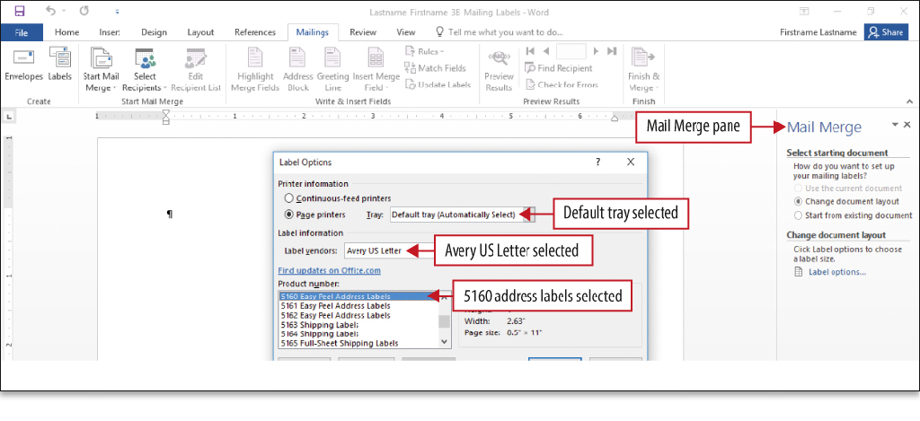
Create Mailing Labels Using Mail Merge
Notes:
An Excel worksheet can be your data source. Each row of information that contains data for one person is referred to as a record. The column headings, for example First Name and Last Name, are referred to as fields.
Address labels are defined in the Label Options dialog box. The Avery 5160 address label is a commonly used label.

Slide 30
Create Mailing Labels Using Mail Merge
Notes:
Not only can you add and edit names and addresses while completing the Mail Merge, but you can also match your column names with preset names used in Mail Merge.

Slide 31
Create Mailing Labels Using Mail Merge
Notes:
If your field names are descriptive, the Mail Merge program will identify them correctly, as is the case with most of the information in the Required for Address Block section. The Address 2 field is unmatched, however; this column is named Unit.

Slide 32
Create Mailing Labels Using Mail Merge
Notes:
Word inserts the Address block in the first label space surrounded by double angle brackets. The AddressBlock field name displays, which represents the address block you saw in the Preview area of the Insert Address Block dialog box.

Slide 33
Create Mailing Labels Using Mail Merge
Notes:
Mailing labels are often sorted by either last name or by ZIP Code. In this case, the labels are sorted in alphabetical order.

Slide 34
Questions ?

Slide 35
Copyright
All rights reserved. No part of this publication may be reproduced, stored in a retrieval system, or transmitted, in any form or by any means, electronic, mechanical, photocopying, recording, or otherwise, without the prior written permission of the publisher. Printed in the United States of America.

