Slide 1
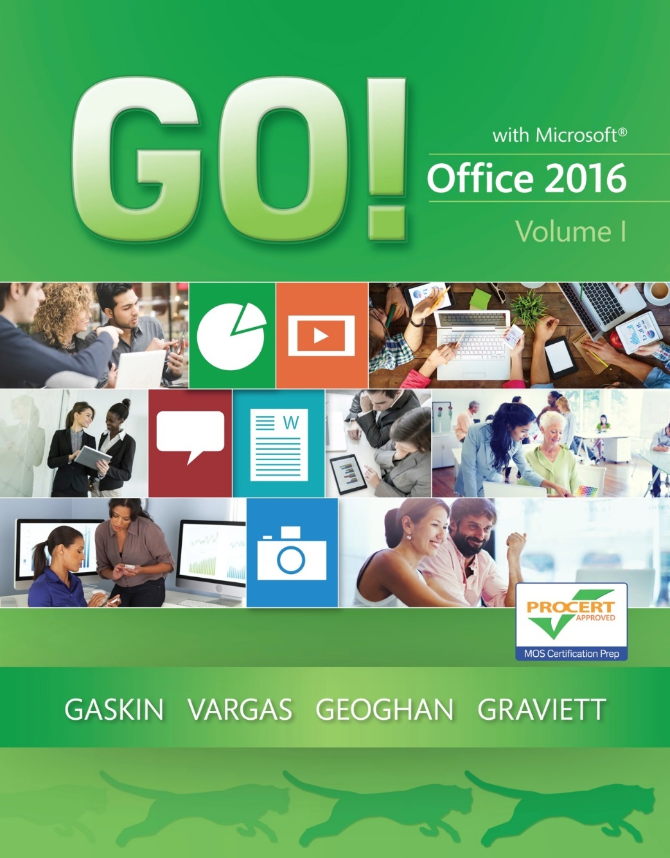
GO! with Microsoft Office 2016
Gaskin Vargas Geoghan Graviett

Slide 2
Word – Chapter 2
Creating Cover Letters and Using Tables to Create Resumes

Slide 3
Objectives
Create a Table
Format a Table
Present a Word Document Online
Create a Custom Word Template
Correct and Reorganize Text
Use the Proofing Options and Print an Envelope
Notes:
Tables are useful for organizing and presenting data. When you create a table in Word, you present the data in rows and columns.
When using Word to write business or personal letters, use a commonly approved letter format, and always use a clear writing style.

Slide 4
Create a Table
Notes:
A table is an arrangement of information organized into rows and columns. The intersection of a row and a column in a table creates a box called a cell into which you can type. Tables are useful to present information in a logical and orderly format. This could be a schedule, a list of classes, or a variety of other information, including a resume.

Slide 5
Create a Table
Notes:
Text typed in a table is inserted at the insertion point.
If you have text in a document that you’d like to convert to a table, use commas or tabs within paragraphs to signal Word to create a column. Then, on the Insert tab, click Table, and click Convert Text to Table.

Slide 6
Create a Table
Notes:
Bullets can be added to text in one or more cells in a table.

Slide 7
Format a Table
Notes:
When you create a table, all of the columns are of equal width. Adjusting column width by dragging a column border adjusts only the width of the column. Adjusting column width with the Width box simultaneously adjusts the right border of the table. Column widths can also be adjusted by dragging the Move Table Column markers on the ruler.

Slide 8
Format a Table
Notes:
The One-click Row/Column Insertion button on the left edge or top of a table can be used to easily and quickly insert a row or column in a table.
When the insertion point is in the last cell in the bottom row of a table, you can add a row by pressing the Tab key.

Slide 9
Format a Table
Notes:
You can merge cells by selecting the cells that you want to merge and then right-click and select Merge Cells.

Slide 10
Format a Table
Notes:
When you create a table, all of the cells have black ½-point, single-line, solid-line borders and there is no shading in the cells of the table. You can change cell or table borders and add shading to one or more cells in the Borders and Shading dialog box.

Slide 11
Format a Table
Notes:
Press Ctrl + P to display Print Preview.

Slide 12
Present a Word Document Outline
Notes:
Office Presentation Service enables you to present your Word document to others who can watch in a web browser. Word creates a link to your document that you can share with others via email or instant message.
The Present Online dialog box shown here provides the online link that you can copy or send in email.

Slide 13
Create a Custom Word Template
Notes:
A template is a file with a predefined document structure and defined settings, such as fonts, margins, and available styles. All documents are based on a template. When you create a new blank document, it is based on Word’s Normal template, which serves as a starting point for all blank Word documents. By default, Word stores template files on your hard drive in your user folder named Custom Office Templates.

Slide 14
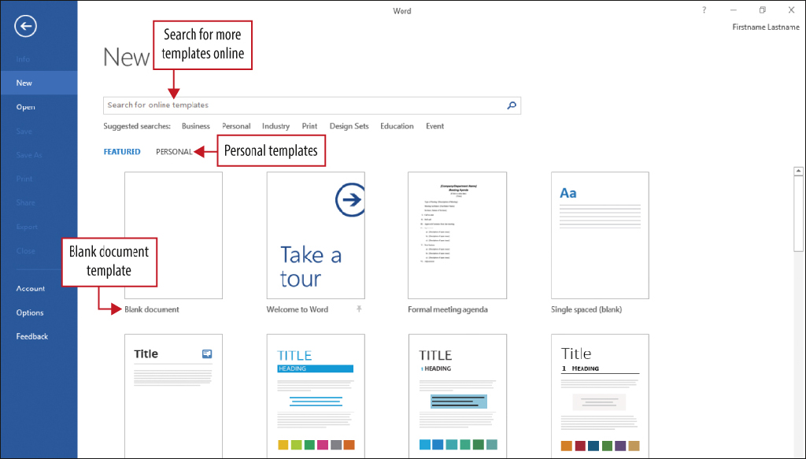
Create a Custom Word Template
Notes:
A letterhead is the personal or company information that displays at the top of a letter, and which commonly includes a name, address, and contact information. A cover letter is a document that you send with your resume to provide additional information about your skills and experience. In Backstage view, you can view personally-created templates such as the letterhead template shown here.

Slide 15
Correct and Reorganize Text
A properly-formatted business letter contains the following parts:
Dateline
The name and address of the person receiving the letter
Also referred to as the inside address
Inside address
A greeting, referred to as the salutation
Body
The text of the letters
Complimentary closing
A closing line in the letter
Writer’s identification
Includes the name or job title (or both) of the writer
Also referred to as the writer’s signature block
Notes:
Business letters follow a standard format and contain the same parts as shown on this slide.

Slide 16
Correct and Reorganize Text
The optional parts of a properly-formatted business letter include:
Initials of the person who prepared the letter
A subject line
Describes the purpose of the letter
Enclosure notation
A list of documents included with the letter
Notes:
These items are optional on a properly-formatted business letter.

Slide 17
Correct and Reorganize Text
Notes:
Word’s AutoCorrect feature corrects commonly misspelled words automatically; for example, teh instead of the. This can be very helpful with business letter writing.

Slide 18
Correct and Reorganize Text
Notes:
By using the Date & Time command, you can select from a variety of formats to insert the current date and time in a document. After the date is inserted in a business letter, one to 10 blank lines, depending on the length of the letter, are inserted prior to typing the inside address.

Slide 19
Correct and Reorganize Text
Notes:
Business letters are typically single-spaced as shown here. Red and blue wavy underlines indicate potential spelling, grammar, or word usage errors.

Slide 20
Correct and Reorganize Text
Notes:
Use the Find command to locate text in a document quickly. Use the Find and Replace command to make the same change, or to make more than one change at a time in a document. A find or find and replace operation begins from the location of the insertion point and proceeds to the end of the document. Therefore, start at the top of a document. With ac typed in the search box, all matches are shown in the left pane.

Slide 21
Correct and Reorganize Text
Notes:
In the Find and Replace dialog box, you can use Match case to match only upper- or lower-case text, you can replace all individual instances of a match with Replace or use Replace All to replace all occasions of the match. The Find and Replace dialog box opens with the same settings used the last time it was open.

Slide 22
Correct and Reorganize Text
Notes:
By using Word’s drag-and-drop feature, you can use the mouse to drag selected text from one location to another. You can also select text quickly once you master the techniques in this table.

Slide 23
Use the Proofing Options and Print an Envelope
Notes:
Word compares your typing to words in the Office dictionary and compares your phrases and punctuation to a list of grammar rules. This automatic proofing is set by default. It is important to recognize, however, that Word will not flag the word sign, for example, as a misspelled word even though you intended to type sing a song rather than sign a song.

Slide 24
Use the Proofing Options and Print an Envelope
Notes:
You should always use Spellcheck for your documents. Use the Spelling & Grammar button on the Review tab or simply press F7.

Slide 25
Use the Proofing Options and Print an Envelope
Notes:
A thesaurus is a research tool that lists synonyms—words that have the same or similar meaning to the word you selected. When you right-click a word in a document and click Thesaurus, the Thesaurus pane opens on the right. A word can then be selected to replace the existing word.

Slide 26
Use the Proofing Options and Print an Envelope
Notes:
Use Word’s Envelopes command on the Mailings label to format and print an envelope. The default envelope size is a standard business envelope referred to as a Size 10.

Slide 27
Questions ?

Slide 28
Copyright
All rights reserved. No part of this publication may be reproduced, stored in a retrieval system, or transmitted, in any form or by any means, electronic, mechanical, photocopying, recording, or otherwise, without the prior written permission of the publisher. Printed in the United States of America.

