Slide 1
GO! with Microsoft Office 2016
Gaskin Vargas Geoghan Graviett

Slide 2
PowerPoint – Chapter 3
Enhancing a Presentation with Animation, Video, Tables, and Charts

Slide 3
Objectives
Customize Slide Backgrounds and Themes
Animate a Slide Show
Insert a Video
Create and Modify Tables
Create and Modify Charts
Notes:
Your presentation can be enhanced by modifying themes, formatting the slide background, or applying animation to slide elements. You can also insert tables and charts that will help your audience understand numeric data and trends. Styles applied to tables and charts unify these slide elements by complementing your presentation theme.

Slide 4
Customize Slide Backgrounds and Themes
Notes:
When a theme is applied to a presentation, you can change the theme colors—a set of coordinating colors that are applied to the backgrounds, objects, and text in a presentation. Changing the colors does not change the overall design. Here, for example, the Retrospect theme is still applied, but the colors that coordinate with the pictures in the presentation are changed.

Slide 5
Customize Slide Backgrounds and Themes
Notes:
Every PowerPoint 2016 presentation includes theme fonts that determine the font applied to the slide text. The Headings font is applied to slide titles and the Body font is applied to all other text. When a new theme font is applied, the text on every slide is updated with the new heading and body fonts.

Slide 6
Customize Slide Backgrounds and Themes
Notes:
A background style is a predefined slide background fill variation that combines theme colors in different intensities or patterns. The background style is applied to all the slides in the presentation.

Slide 7
Customize Slide Backgrounds and Themes
Notes:
Sometimes the background graphics interfere with or clash with the slide content. When this happens, you can hide the background graphics. You can hide background graphics on one slide, multiple slides, or all slides.

Slide 8
Customize Slide Backgrounds and Themes
Notes:
A fill color can be applied to a background on one or more slides. The Texture gallery is also available to use as a background, as shown here.

Slide 9
Customize Slide Backgrounds and Themes
Notes:
You can also insert a picture on a slide background. The image fills the entire slide and, as such, the picture is not treated as an object. You cannot move or resize the picture.

Slide 10
Animate a Slide Show
Notes:
Animation is a visual or sound effect added to an object or text on a slide. Using animation to focus the audience’s attention, it provides the speaker with an opportunity to emphasize important points using the slide element as an effective visual aid. The Animation gallery offers many options for animation effects.

Slide 11
Animate a Slide Show
Entrance effect
Animation that brings a slide element onto the screen
Emphasis effect
Animation that emphasizes an object or text that is already displayed on the screen
Exit effect
Animation that moves an object or text off the screen

Slide 12
Animate a Slide Show
Notes:
Numbers next to slide elements indicate the order in which text or objects will be animated during the slide show.

Slide 13
Animate a Slide Show
Notes:
The Effect Options command controls the direction and sequence in which the animation displays. Additional options may be available with other entrance effects.

Slide 14
Animate a Slide Show
Notes:
There are more entrance effects than first displayed on the ribbon. In the Animation group, click More, and then click More Entrance Effects. The Change Entrance Effect dialog box displays additional entrance effects grouped in four categories: Basic, Subtle, Moderate, and Exciting.

Slide 15
Animate a Slide Show
Notes:
Timing options control when animated items display in the animation sequence. The On Click option begins the animation sequence when the mouse button is clicked or the Spacebar is pressed. With Previous begins the animation sequence at the same time as the previous animation or slide transition. After Previous begins the animation sequence immediately after the completion of the previous animation or slide transition. Timing can also be controlled for each of these settings.

Slide 16
Animate a Slide Show
Notes:
Animation Painter copies animation settings from one bulleted list or object to another bulleted list or object. The animation effects from the bulleted list on Slide 3 of this presentation were copied and, using the Animation Painter, were applied to the bulleted list of Slide 4. The animation effect of the image on Slide 3 was then copied, using the Animation Painter, to the image on this slide.

Slide 17
Insert a Video
Notes:
A video inserted in a slide can be sized and moved, as well as having styles and effects applied. You can also trim parts of the video and compress the video to make the presentation easier to share. When a video is inserted, it displays in the center of the slide, and media controls display in the control panel below the video.

Slide 18
Insert a Video
Notes:
This video has been centered horizontally and vertically, as well as resized, with the alignment features on the Format tab in the Arrange group.

Slide 19
Insert a Video
Notes:
You can format a video with any combination of styles, shapes, and effects.

Slide 20
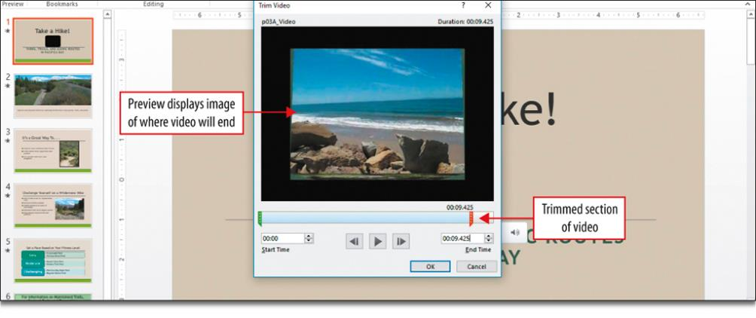
Insert a Video
Notes:
You can trim—delete parts of a video to make it shorter—and you can compress a video file to reduce the file size of your PowerPoint presentation.

Slide 21
Insert a Video
Notes:
Video files are typically quite large in size. The Compress Media dialog box displays the slide number on which the selected video is inserted, the video file name, the original size of the file, and when compression is complete, the amount that the file size was reduced.

Slide 22
Create and Modify Tables
Notes:
A table is a slide object that presents text and data in columns and rows. The intersection of a column and row is a cell and is the location in which you type text in a table. You can insert a table with the Insert Table button in a content placeholder or through the Insert tab.

Slide 23
Create and Modify Tables
Notes:
When a table is inserted, the insertion point defaults to the top left cell of the table. Type text in a cell and press the Tab key to quickly and easily move the insertion point to the next cell. When the insertion point is positioned in the last cell of a table, pressing Tab inserts a new blank row at the bottom of the table, as shown here in this slide.

Slide 24
Create and Modify Tables
Notes:
Columns and rows can be inserted or deleted by using the commands on the Layout tab.

Slide 25
Create and Modify Tables
Notes:
When a table is selected, it is surrounded by sizing handles that can be used to resize the table. A dim border and the red dotted ruler guides display, indicating the new size of the table.

Slide 26
Create and Modify Tables
Notes:
Table rows and columns can be distributed evenly by using the commands on the Layout tab.

Slide 27
Create and Modify Tables
Notes:
You can modify the design of a table by applying a table style. A table style formats the entire table so that it is consistent with the presentation theme. There are color categories within the table styles—Best Match for Document, Light, Medium, and Dark.

Slide 28
Create and Modify Charts
Notes:
A column chart is useful for illustrating comparisons among related numbers. The Insert Chart icon displays in a content placeholder. You can also insert a chart from the Insert tab.

Slide 29
Create and Modify Charts
Notes:
When you create a chart, a Chart in Microsoft PowerPoint worksheet window displays with cells, columns, and rows. A cell is identified by the intersecting column letter and row number, forming the cell reference. Included are:
Column headings that display in the chart legend
Row headings that display as category labels

Slide 30
Create and Modify Charts
Notes:
The various parts of the chart are shown here. To the right of the chart, three buttons display:
Chart Elements button: enables you to add, remove, or change chart elements
Chart Styles button: enables you to set a style and color scheme for your chart
Chart Filters button: enables you to change which data displays in the chart

Slide 31
Create and Modify Charts
Notes:
A chart style is a set of predefined formats applied to a chart, including colors, backgrounds, and effects. Chart elements are the various components of a chart, including the chart title, axis titles, data series, legend, chart area, and plot area.

Slide 32
Create and Modify Charts
Notes:
A line chart is commonly used to illustrate trends over time. The features available to enhance a line are similar to a column chart.

Slide 33
Create and Modify Charts
Notes:
As with any other object in PowerPoint, you can animate a chart. There are several options available. Charts can be animated as one object or, by using the By Series option, you can display the chart one data series at a time.

Slide 34
Questions ?

Slide 35
Copyright
All rights reserved. No part of this publication may be reproduced, stored in a retrieval system, or transmitted, in any form or by any means, electronic, mechanical, photocopying, recording, or otherwise, without the prior written permission of the publisher. Printed in the United States of America.

