Slide 1
GO! with Microsoft Office 2016
Gaskin Vargas Geoghan Graviett

Slide 2
PowerPoint – Chapter 2
Formatting PowerPoint Presentations

Slide 3
Objectives
Format Numbered and Bulleted Lists
Insert Online Pictures
Insert Text Boxes and Shapes
Format Objects
Remove Picture Backgrounds and Insert WordArt
Create and Format a SmartArt Graphic

Slide 4
Format Numbered and Bulleted Lists
Notes:
A bulleted list, sometimes called an unordered list, is a list of items preceded by small dots or other shapes, which do not indicate order or rank. A numbered list, also known as an ordered list, displays items preceded by numbers, which indicate sequence or rank of the items. The font, color, and style of a bulleted or numbered list are determined by the theme.

Slide 5
Format Numbered and Bulleted Lists
Notes:
You can change the bullet color and style by using the commands in the Paragraph Group. You can easily change a bulleted list to a numbered list. This shows an example of bulleted symbols converted to a numbered list.

Slide 6
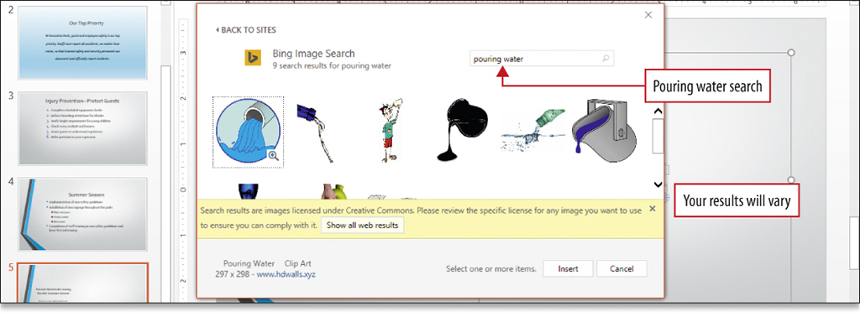
Insert Online Pictures
Notes:
One type of image that you can insert on to a slide is a clip—a single media file such as art, sound, animation, or a movie. The Online Pictures button in a placeholder opens the Insert Pictures dialog box. You can then search for an image using one or more keywords. The results are licensed under Creative Commons, a nonprofit organization that enables use of images.

Slide 7
Insert Online Pictures
Notes:
When an image is inserted and then selected, sizing handles display. Sizing handles can be used to resize the image. You can also resize the image using the Shape Height and Shape Width boxes on the Format tab. When sizing handles are used to resize the image, the width adjusts in proportion to the picture height.

Slide 8
Insert Online Pictures
Notes:
Smart guides are dashed lines that display on your slide when you are moving an object to assist you with alignment. Smart guides display when you move an object and you align it with another object on the slide. Pressing the Shift key while moving an object constrains the movement in a straight line either vertically or horizontally.

Slide 9
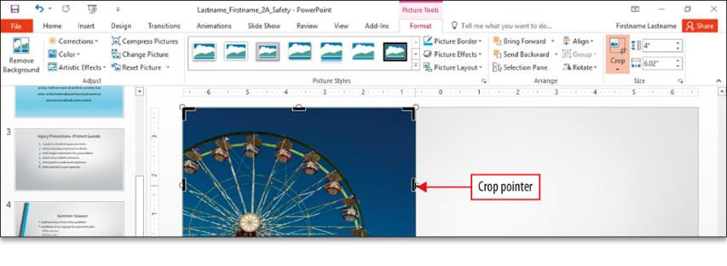
Insert Online Pictures
Notes:
When you crop a picture—as shown here—you remove unwanted or unnecessary areas of a picture. Crop handles are similar to sizing handles and are used to remove unwanted areas of the picture. The crop pointer is the mouse pointer that displays when cropping areas of a picture. The portion of a picture to be removed by the drop displays in gray.

Slide 10
Insert Online Pictures
Notes:
Most pictures are inserted on a slide in a rectangular shape. You can modify that picture by changing its shape. Here you see the picture cropped to an oval shape.

Slide 11
Insert Text Boxes and Shapes
Notes:
A text box is an object with which you can position text anywhere on a slide. Text boxes can be formatted by changing the font, font size, and font color.

Slide 12
Insert Text Boxes and Shapes
Notes:
Shapes are slide objects such as lines, arrows, boxes, callouts, and banners. You can size and move a shape using the same techniques that you use to size and move pictures.

Slide 13
Insert Text Boxes and Shapes
Notes:
You can also add text to a shape. After you add text to a shape, you can change the font and font size, apply font styles, and change text alignment.

Slide 14
Format Objects
Notes:
One interesting way to format a shape is by changing the fill color—the inside color of text or of an object—and the outside line color. The Shape Styles gallery can be used to apply predefined combinations of these fill and line colors and also to apply other effects.

Slide 15
Format Objects
Notes:
The eyedropper is a tool that captures the exact color from an object on your screen and then applies it to any shape, picture, or text. The eyedropper can be used to give a presentation a cohesive look by matching a font color, fill color, border color, or other slide element to any color on any slide.

Slide 16
Format Objects
Notes:
It is quick and easy to duplicate an object with Ctrl + D. The duplicated object overlaps the original picture and the duplicated image is selected. You can then use the Picture Tools Format tab, and the Align button to align selected objects on the slide.

Slide 17
Format Objects
Notes:
You can select multiple objects and group them so that they can be formatted and edited as one object. Once objects are grouped, the sizing handles surround all shapes as one, indicating that the shapes are grouped into one object. The grouped object can be formatted, aligned, and moved as one object.

Slide 18
Remove Picture Backgrounds and Insert WordArt
Notes:
The Background Removal command removes unwanted portions of a picture so that the picture does not appear as a self-contained rectangle. This enables you to flow a picture into the content of the presentation.

Slide 19
Remove Picture Backgrounds and Insert WordArt
Notes:
WordArt is a gallery of text styles with which you can create decorative effects, such as shadowed or mirrored text.

Slide 20
Remove Picture Backgrounds and Insert WordArt
Notes:
You can also add text effects to add interest to a slide. Text effects are formats applied to text that include shadows, reflections, glows, bevels, and 3-D rotations.

Slide 21
Create and Format a SmartArt Graphic
Notes:
A SmartArt graphic is a visual representation of information that you create by choosing from among various layouts to communicate your message or ideas effectively. The SmartArt gallery is divided into types on the left, a visual image of the graphic in the middle, and a description on the right.

Slide 22
Create and Format a SmartArt Graphic
Notes:
Additional shapes can be added to a SmartArt graphic. The text in each of the SmartArt shapes resizes to accommodate the added shape.

Slide 23
Create and Format a SmartArt Graphic
Notes:
Some SmartArt graphics include shapes in which to insert pictures, as shown here. You can also select individual or groups of shapes in a SmartArt graphic and make them larger or smaller, and you can change selected shapes to another type of shape.

Slide 24
Create and Format a SmartArt Graphic
Notes:
SmartArt Styles are combinations of formatting effects that you can apply to SmartArt graphics.

Slide 25
Create and Format a SmartArt Graphic
Notes:
Text in a SmartArt graphic can be converted to text on the slide. On the SmartArt Tools Design tab, in the Reset group, click Convert, and then click Convert to Text to convert the SmartArt graphic to a bulleted list.

Slide 26
Questions ?

Slide 27
Copyright
All rights reserved. No part of this publication may be reproduced, stored in a retrieval system, or transmitted, in any form or by any means, electronic, mechanical, photocopying, recording, or otherwise, without the prior written permission of the publisher. Printed in the United States of America.

