Slide 1
GO! with Microsoft Office 2016
Gaskin Vargas Geoghan Graviett

Slide 2
Access – Chapter 2
Sort and Query a Database

Slide 3
Objectives
Open and Save an Existing Database
Create Table Relationships
Sort Records in a Table
Create a New Query from an Existing Query
Sort Query Results
Specify Criteria in a Query
Specify Numeric Criteria in a Query
Use Compound Criteria in a Query
Create a Query Based on More Than One Table
Use Wildcards in a Query
Create Calculated Fields in a Query
Calculate Statistics and Group Data in a Query
Create a Crosstab Query
Create a Parameter Query

Slide 4
Open and Save an Existing Database
Notes:
There are instances when you need to work with a database and make a copy of the database so you have a copy of the original in case the database becomes corrupt when you work on it.
To save the database with a different name, click the File tab, click Save As, then Save Database As, and give the database a new name. You still have the original and a duplicate to work on.
You can also save a database in a format that will enable the database to be opened with Access 2007, Access 2010, or Access 2013. The Message Bar, which is located directly below the ribbon, displays information such as security alerts when there is potentially unsafe, active content in the document.

Slide 5
Create Table Relationships
Notes:
Access databases are relational databases. Tables can be related to other tables or queries on a common field. Common fields are fields in one or more tables that store the same data. To relate tables on a common field, you have to define a relationship. A relationship is an association that is established between two tables on a common field. After the relationship is established, you can create a query, report, or form to display information from more than one table.
Use the Database Tools tab to find the Relationship group. Click Relationships. Use the Show Tables dialog box to show the list of tables in the database. Choose the two tables that have a common field. Close the Show Tables dialog box. The two tables will show their field lists, which is a list of the fields in each table.

Slide 6
Create Table Relationships
Notes:
By dragging the common field in one table to the same field in the other table, you establish a relationship. In many instances, the common field will be the primary key in the “one” table, and the foreign key in the “many” table. This type of relationship is called a one-to-many relationship.
Referential integrity is a set of rules that Access uses to ensure that the data between related tables is valid. Enforcing referential integrity ensures that the common field cannot be added to a table unless it has been added to the “one” table first.
The Cascade Update Related Fields option enables you to change the data in the primary key field for the table on the one side of the relationship, and updates automatically change an fields in the related table.
The Cascade Delete Related Records option enables you to delete a record in the table on the one side of the relationship and also delete all of the related records in related tables.
The join line is the line connecting or joining the two tables.

Slide 7
Sort Records in a Table
Notes:
Sorting is the process of arranging data in a specific order based on the value in a field; for instance, sorting by last name. To sort records in a table, click the arrow to the right of the field name in the table and click the sort order.
Data can be sorted in ascending or descending order. Ascending order is alphabetical (A-Z) or numbers lowest to highest. Descending order is alphabetical (Z-A) or numbers highest to lowest.
Sorting can be done on more than one field at a time, but the outermost sort field would be first and the innermost sort field would be the second level sort.

Slide 8
Create a Query in Design View
Notes:
Queries are used to create subsets of records, a portion of the total, according to specific specification. Tables that the queries are based on are called its data source.
Queries can be created from scratch, using the Query Design view. Using the Show Table box, you can select the table needed for the query. The table appears in the table area of the Query window. The grid at the bottom of the Query design window is called the query design grid. The fields needed for the query will be listed there. Drag the field name from the table area to the grid in the order in which you want them to appear in the query.
To see the result of the query, you would run the query.

Slide 9
Create a New Query from an Existing Query
Notes:
You can create a new query from scratch or you can open an existing query and modify it, then save it with a different name. You can also copy an existing query and paste it. To rename the new query, right-click and rename.
Making any changes to a query do not have any effect on the table. To delete a field from a query, right-click on the field name in the grid and delete it. You can also point to the thin gray selection bar above the field name to display the down arrow pointer and click to select the column and delete.

Slide 10
Sort Query Results
Notes:
You can sort the results of a query in either Datasheet view or Design view. Use Design view if you want the results to always appear in a specific sorted order.
To sort in Design view, click the Sort row under the field name in the grid. Choose Ascending or Descending. When you Run the query, records will be sorted as you specified. If you want records sorted on more than one field, you must choose Sort on both fields. It is important to remember that records are sorted in the order they appear in the grid.

Slide 11
Specify Criteria in a Query
Notes:
Queries find information from the table based on criteria that you specify in the query design. Criteria are conditions that you are looking for from the table. When you run a query based on criteria, you are answering a question.
Access places quotation marks (“) around criteria in the query grid to indicate that you are looking for a text string or a sequence of characters. You would use the criteria row to add the criteria you are looking for. The criteria is not case sensitive.

Slide 12
Specify Criteria in a Query
Notes:
You can add specific criteria in the design grid, in this case adding Professor in the Rank field. When you run the query, your result will show only those Instructors who have the Rank of Professor. This query is also being sorted on the Last Name field so students will be in alphabetical order according to their Professor.

Slide 13
Specify Criteria in a Query
Notes:
To find records where data is missing, you can use Is Null to find empty fields. When you Run the query, only those fields where this field is blank will be displayed. Is Not Null would display records where the specified field is not empty.

Slide 14
Specify Numeric Criteria in a Query
Notes:
Criteria can be used for fields containing numeric data. When designing a table, appropriate data types should be set for fields that will contain numbers, currency, or dates so that calculations can be performed.
When using numeric criteria in a query, formatting is not considered; in other words, do not use dollar signs. Decimal points would only be used if looking for a specific amount that includes cents. Access will not insert quotation marks around the criteria because it is not text.

Slide 15
Specify Numeric Criteria in a Query
Notes:
Comparison operators are symbols that are used to evaluate data in the field. Common Comparison operators are: (=) the same or equal, (>) greater than, (<) less than, or in between a range of values. If no comparison operator is specified, (=) is assumed.
The Between…And operator is a comparison operator that looks for values between two specific ranges.

Slide 16
Use Compound Criteria in a Query
AND Criteria, appears
on the same line
OR Criteria, appears
on two lines
Notes:
You can specify more than one criteria in a query. This is called a compound criteria. Compound criteria use AND and OR logical operators. In the query grid, AND criteria would appear on the same line for the fields specified. OR criteria would appear on two lines in the grid, the second criteria appearing on the OR line.

Slide 17
Create a Query Based on More Than One Table
Notes:
In a relational database, you can retrieve information from more than one table. The tables should be joined to each other on a common field in a relationship.
In the query grid, the table row will show which table the field is from. When the query is run, you can see the fields together in one table format.

Slide 18
Create a Query Based on More Than One Table
Notes:
When you create a query on two tables, the query will appear in the Navigation pane under both tables.

Slide 19
Use Wildcards in a Query
Notes:
Wildcard characters are used to represent one or more unknown characters in a string. When you are unsure of the specific character or set of characters to include in a criteria for a query, you would use a wildcard character in place of the character.
There are two types of wildcards:
(*) asterisk is used to represent one or ore unknown characters. An asterisk (*) can be used at the beginning, middle, or end of the criteria
(?) question mark is used for a specific character in a word like b?d to find results such as bed, bid, or bud, or any other three character word that begins with b and ends with d

Slide 20
Create Calculated Fields in a Query
Notes:
You can create a calculated field in a query. A calculated field stores the value of the mathematical operation.
There are two steps to create a calculated field. Step one is to name the field that will store the result of the calculation. The second step is to enter the expression (formula) for the calculated field. The name must be followed by a colon (:) and each field name must be enclosed in their own pair of square brackets.

Slide 21
Calculate Statistics and Group Data in a Query
Notes:
Queries can be used to perform statistical calculations known as aggregate functions on a group of records. You can find the average amount for a group of records or the highest number in a group of records.

Slide 22
Calculate Statistics and Group Data in a Query
Notes:
To use the aggregate functions in a query, you have to turn the Total key on in the Show/Hide group. When the Total key is clicked, the Total row is added to the design grid. Group by displays. Click the arrow to display a list of the aggregate functions and choose the one you need.

Slide 23
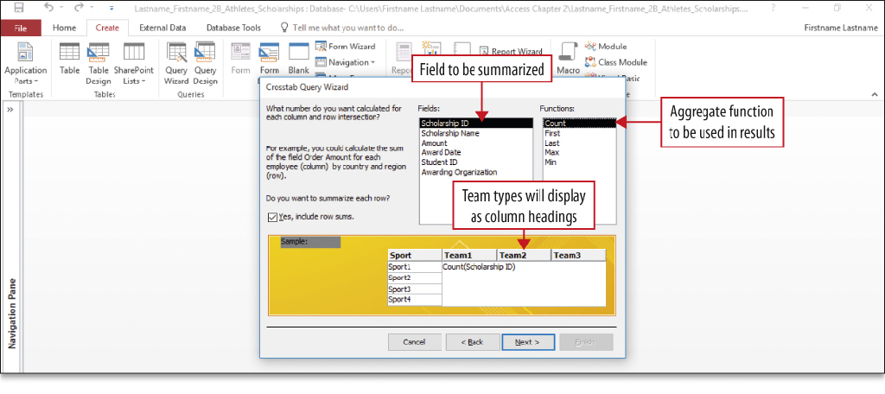
Create a Crosstab Query
Notes:
A crosstab query uses an aggregate function for data that can be grouped by two types of information, and displays the data in a compact, spreadsheet-like format. It always has at least one row heading, one column heading, and one summary field.
The crosstab query wizard walks you through the steps to create a crosstab query.

Slide 24
Create a Crosstab Query
Notes:
Shown here is the result of a crosstab query. It summarizes the information you requested in your query.

Slide 25
Create a Parameter Query
Notes:
A parameter query prompts you for criteria before running the query. To display records for students in a specific city, you would create a parameter query for city. The parameter query eliminates the need to change the design of a select query.

Slide 26
Summary
Table relationships are created to allow you to extract information from multiple tables
Queries are the answers to questions posed in specific ways
Queries range from simple to complex
Crosstab queries display information grouped by two fields
Parameter queries allow you to answer a prompt for information
Notes:
Table relationships are created by joining tables together on a common field. This allows you to use more than one table in a query, form, or report to pull information pertaining to both with no duplication of information.
Queries are created to answer questions and to get information from database tables. This tends to save time when you just need to answer a simple question.
Queries can ask one question or several questions on the same information by forming compound criteria, wildcard characters, logical operators, and calculated fields.
Queries range from simple queries to more complex queries like crosstab queries and parameter queries.

Slide 27
Questions ?

Slide 28
Copyright
All rights reserved. No part of this publication may be reproduced, stored in a retrieval system, or transmitted, in any form or by any means, electronic, mechanical, photocopying, recording, or otherwise, without the prior written permission of the publisher. Printed in the United States of America.

