Slide 1
GO! with Microsoft Office 2016
Gaskin Vargas Geoghan Graviett

Slide 2
Access – Chapter 3
Forms, Filters, and Reports

Slide 3
Objectives
Create and Use a Form to Add and Delete Records
Filter Records
Create a Form by Using the Form Wizard
Modify a Form in Layout View and Design View
Create a Report by Using the Report Tool and Modify the Report in Layout View
Create a Report by Using the Report Wizard
Modify the Design of a Report
Keep Grouped Data Together in a Printed Report

Slide 4
Create and Use a Form to Add and Delete Records
Notes:
A form is a database object that can be used to display existing records in a table, one record at a time. A form can be used to add new records, change existing records, or delete specific records. Forms are based on tables where the records are stored. This is referred to as being bound to the table.
Using a form to add a new record is called data entry.
There are several ways to create a form in Access, but the easiest way is to use the Form tool. A form can be created using a single mouse click, all the fields in the table are listed in the form in sequential order. This form can be used immediately to add or edit records. Records are automatically updated in the table when edited in form view.

Slide 5
Filtering Records
Notes:
Filtering records in a form displays only a portion of the total records—a subset—based on matching values. Filters are generally used to find quick answers to a question when a query is not necessary. Filters do not have to be saved, but can be if you will be using the filter again.
There are two types of filters:
Filter by Selection which displays only the records that contain the value in the selected field
Filter by Form filters records based on one or more fields, or based on more than one value in the same field
Filter by Form offers greater flexibility than Filter by Selection.

Slide 6
Filter Records
Notes:
For more advanced sorting, use Advanced Filter. In the Sort & Filter group, click Advanced/Filter/Sort. The Advanced Filter design grid displays, which is similar to the query design grid.
To turn a filter on or off, use the Toggle Filter command in the Sort & Filter dialog box. To clear a filter, click Clear All Filters.

Slide 7
Create a Form by Using the Form Wizard
Notes:
The Form Wizard walks you step by step through the creation of a form and gives you more flexibility in the design, layout, and number of fields in a form than the Form tool. Forms are designed for the user of the form.

Slide 8
Modify a Form in Layout View and in Design View
Notes:
After a form is created, you can make changes to it. The Layout view enables you to see the data in the form as you modify it. Most changes to a form can be made in Layout view.
There are controls for forms that you must work with when modifying a form.
Text box controls typically display data from a field in the underlying table. A text box control is a bound control, that is its data comes from a field in a table.
Label controls display to the left of the text box control and those contain descriptive information on the form, usually the field names.
Unbound controls are controls that do not have a data source. An example of an unbound control is the title.
In Layout view, you can change the forms control layout or the grouped arrangement of controls. Each control has an associated Property Sheet where precise changes to the properties or characteristics can be made.

Slide 9
Modify a Form in Layout View and in Design View
Notes:
Design view presents a detailed view of the structure of the form. Because the form is not running when displayed in Design view, the data does not display in the text box controls.
The Design view displays three sections, separated by section bars at the top of each section.
The Form Header contains information about the form itself, like it’s title.
The Detail section displays the records from the underlying table.
The Form Footer displays at the bottom of the screen in Form view or Layout view and is printed after the last detail section on the last page of a printout.
The Property Sheet can be displayed for each section of the form.

Slide 10
Create a Report by Using the Report Tool and Modify the Report in Layout View
Notes:
A report is a database object that summarizes the fields and records from a query, form, or table in an easy-to-read format suitable for printing. A report consists of information that has been extracted from queries or tables. The queries or tables provide the underlying data for the report, referred to as the report’s record source.
The Report tool is the fastest way to create a report, because it displays all of the fields and records from the source you selected. The Report tool is used to look at the underlying data quickly in an easy-to-read format. The Report can be saved and modified in Layout view or Design view.

Slide 11
Create a Report by Using the Report Tool and Modify the Report in Layout View
Notes:
In a report created by using the Report tool, a calculated control is automatically created to sum any field that is formatted as currency. A calculated control contains an expression, often a formula or function. If the total is not useful to the report, it can be deleted.
If the page number that displays at the bottom of the report does not fit entirely within the margin of the report, it can be moved by using the Property Sheet to adjust it.

Slide 12
Create a Report by Using the Report Wizard
Step 1, choose the table and fields
Step 2, choose the field for grouping
Notes:
Use the Report Wizard when you need more flexibility in the design of the report. You can group and sort data by using the wizard and use fields from more than one table or query as long as a relationship has been created between the tables. The Report Wizard is very similar to the Form Wizard. It walks you step by step through the process of creating a report by asking questions and design options for your report.
Step 1 – you would choose the table to be included in the Report and then the fields in the order they should appear in the Report.
Step 2 – you would choose the field for grouping if you want to group the Report; however, this step is not necessary.

Slide 13
Create a Report by Using the Report Wizard
Notes:
Shown here is the report with the groups and sorts completed. The Report name is shown in blue.

Slide 14
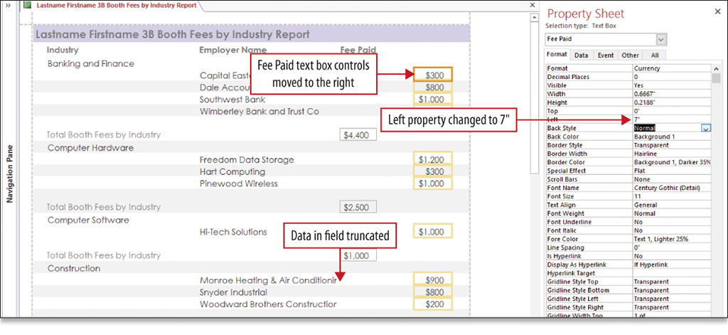
Modify the Design of a Report
Notes:
A report can be modified in Layout view and Design view.
In Layout view, just as in a form, the field names and data are displayed. You can modify the layout by clicking the control. When the control is clicked, all the related controls are also selected. You can resize fields, change font size, and move controls at the same time.
You can also delete unneeded controls in the same manner.
The Property Sheet can be used to make any changes to the report also.

Slide 15
Modify the Design of a Report
Notes:
You can modify the design of a report created with the Report Wizard just as you can when you create a report using the Report tool. Just as a form, the report has two ways to modify the design, using the Layout view and the Design view.
Just as a form, the Design view is divided into sections:
Report Header section includes the title of the report
Page Header section displays information at the top of every page
Group Header displays the name of data in the field that has been grouped
Detail section displays the data for each record
Group Footer displays the summary information for each group
Page Footer section displays information at the bottom of each page
Report Footer section displays information at the bottom of the last page of the report

Slide 16
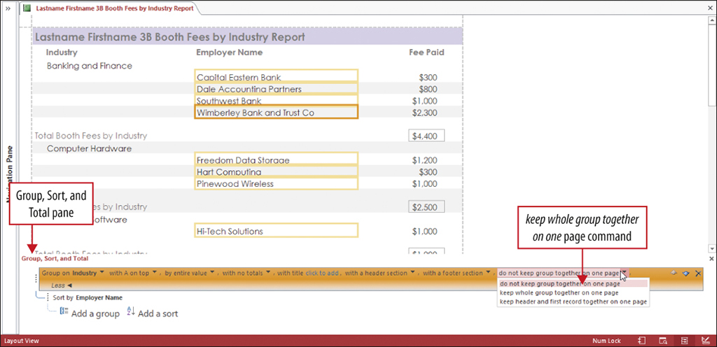
Keep Grouped Data Together in a Printed Report
Notes:
Before printing a report, use Print Preview to be sure that all the labels and data display fully and to be sure that all the data is properly grouped. Sometimes a page will break in the middle of a group with the labels on one page and the data or summary information on another.
To prevent this from happening use Layout view. On the Design tab, open Group & Sort, at the bottom of the screen the Group, Sort, and Total pane displays. Specify to keep whole group together on one page command.

Slide 17
Summary
A form is used to control access to the data in a database
Filter records in a form to display a subset
A report is an easy-to-read format suitable for printing
Changes to forms can be done in Layout View or Design View
Notes:
A form is a database object that you can use to enter new records into a table, or to edit, delete, or display existing records in a table and can be used to control access to the data in a database.
Filter records in a form to display only a subset of the total records based on matching specific values to provide a quick answer to a question; filters are generally not saved with a form.
A report is a database object that summarizes the fields and records from a query or from a table, in an easy-to-read format suitable for printing. You can group records and summarize the data in a report.
Most changes to forms and reports can be done in Layout view where the underlying data displays in the controls; however, some modifications, such as aligning controls, must be done in Design view.

Slide 18
Questions ?

Slide 19
Copyright
All rights reserved. No part of this publication may be reproduced, stored in a retrieval system, or transmitted, in any form or by any means, electronic, mechanical, photocopying, recording, or otherwise, without the prior written permission of the publisher. Printed in the United States of America.

