Slide 1
GO! with Microsoft Office 2016
Gaskin Vargas Geoghan Graviett

Slide 2
Access – Chapter 1
Getting Started with Microsoft Access 2016

Slide 3
Objectives
Identify Good Database Design
Create a Table and Define Fields in a Blank Desktop Database
Change the Structure of Tables and Add a Second Table
Create a Query, Form, and Report
Close a Database and Close Access
Use a Template to Create a Database
Organize Objects in the Navigation Pane
Create a New Table in a Database Created with a Template
Print a Report and a Table

Slide 4
Identify Good Database Design
Access 2016 is a relational database management system
Database – an organized collection of data
Information – data organized in a useful manner
Flat database – simple database, not related to other data
Relational database – database, multiple collections are related
Notes:
Access is a relational database management system, referred to as a DBMS which is software that controls how related pieces of data are stored, organized, retrieved, and secured. There are two basic types of databases systems, a flat or simple database and a relational database. In a flat database, there are no related pieces of data. In a relational database, there are multiple pieces of data that are related in some way to each other.
An example of a flat database would be your address book. You would not need to duplicate any addresses.
An example of a relational database could be a store’s inventory because there should also be a list of suppliers. There should be separate tables for the inventory and the suppliers, with a field that would relate them in some way, like a supplier identification field.

Slide 5
Identify Good Database Design
Tables – the foundation of an Access database
Record – all the data relating to one person, place, event, thing, or idea is stored
Field – a single piece of information for every record
Notes:
When creating a database, the first step is to decide what information you want to be included, what questions should the database answer. The purpose of the database is to have the information in the database so the answers to any questions would be easy to do.
Tables are the foundation of an Access database. All information is stored in tables. Tables are similar to an Excel spreadsheet because they are created in columns and rows.
A record is where all the information about one particular person, place, event, thing, or idea is stored. Such as everything about you as a student.
A field is a list of all the items included in the table. For example, your name could be used as three fields, your last name, first name, and middle initial.

Slide 6
Identify Good Database Design
First principle of a good database design
- organize data so there is no duplication of information
Second principle of a good database design
- use techniques to ensure that data is consistent
Notes:
The first principle of a good database design is to organize the data in such a way that there is no duplication of information. For instance, a supplier changed its location. Instead of creating a new record for that supplier, modify the existing record with the change.
The second principle of a good database design is to use techniques to ensure that the data is entered in such a way that it is consistent. A good example would be with the way the state is referred to. Some people abbreviate the state when they refer to it, others do not, so to be consistent, you would decide which way you would enter the state.

Slide 7
Create a Table and Define Fields in a Blank Desktop Database
From the Microsoft Access 2016 start screen, you can
open an existing database
create a custom web app
create a blank database
create a new database based on a
template
Notes:
Normalization is very important because your goal in creating a database is to have it perform as you expect it to. When normalization rules are not followed, the database is useless.
Tables in a relational database are joined to one another on a common field—a field that is in both tables.
From this screen, you can open an existing database, create a new custom web app database, create a blank database, or create a new database based on a template.

Slide 8
Create a Table and Define Fields in a Blank Desktop Database
To create a blank database
Click Browse to choose the location for the database
Name the file in the File Name box
Click Create
Notes:
A blank desktop database is stored on your computer or other storage device. It is a shell with no data. You create the data and tools as they are needed.
To create a blank database, clock Browse to choose the location of the database, then name the database in the File Name box. Click Create to create the database shell.

Slide 9
Create a Table and Define Fields in a Blank Desktop Database
Table in datasheet view
Navigation pane displays objects that can be opened
Object tab identifies open objects
Object window displays active or open object(s)
Notes:
This is the first view you have after creating a blank database. This view is called Datasheet view. The table is called Table 1 because it is a table that has not been named. Datasheet view looks similar to an Excel spreadsheet because it is set up in columns and rows.
Captions can be created for field names to reduce the amount of space in the column heading. An example of a caption would be LName for Last Name.
A description can be added to a field name if necessary for additional information on the purpose of a field. However, it is not necessary.

Slide 10
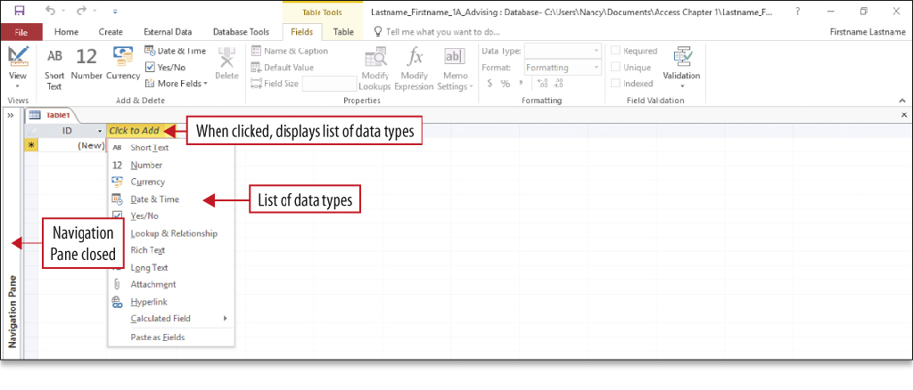
Create a Table and Define Fields in a Blank Desktop Database
Examples of Data types
Short text – up to 255 characters
Date & Time – date or time
Auto Number – unique sequential numbers
Currency – amounts
Notes:
A data type is the kind of data that can be stored in a field. A field can have only one data type. Examples of data types are Short text, Date & Time, Auto Number, Currency, and Number.
Field names should be specifically related to the data included in the table. Examples of field names are Last Name, First Name, and Middle Initial. Many designers do not use spaces in field names so Last Name would become LName.
Fields such as Postal Code should be assigned Short text because the field will never be used in a calculation.
Fields that involve numbers should be labeled number fields. If they are currency, they should be labeled currency.

Slide 11
Create a Table and Define Fields in a Blank Desktop Database
Notes:
You can key records directly into a table or you can import the data from a variety of sources such as Excel. Importing is copying the data from one source to another.
If you want to add to an existing table, you would append the data. To append the data, the table needs to have already been created and be closed.
The source file is the file that is being imported. There are three ways to import data from an Excel spreadsheet: import into a new table in the current database, append (copy) the data to an existing table, or link the data to a linked table in the database. A link is a connection to another file. When you link a file, any changes made in one will be made in the other.
To append records to an existing table, the field names and the column headings have to be identical. If they are not, the table will not copy. A wizard is a feature of Access that walks you through the process of importing records from one file to another.

Slide 12
Change the Structure of Tables and Add a Second Table
Primary key – unique identifier – Cannot be duplicated in table
Notes:
The Primary key is a unique identifier that identifies a record. A good example of a unique identifier would be a student ID. No student should have the same ID as another, that makes it unique. It is a good practice to create a primary key in every table to make sure you do not enter the same record more than once.

Slide 13
Change the Structure of Tables and Add a Second Table
Notes:
Excel spreadsheets can be imported or linked into Access.

Slide 14
Change the Structure of Tables and Add a Second Table
Notes:
Many times it is necessary to print in Access. There are numerous ways to print. When printing, it is best to use Print Preview to view your table to make sure all the information is readable. Many times, you have to change the orientation from Portrait to Landscape to see all the fields. You can also use Fit to Window to see how the table will look. If the table covers more than one page, you will see the Next Page button available to print.

Slide 15
Create a Query, Form, and Report
Notes:
A query is the answer to a question. When a database query is created, the result of the query appears as one datasheet.
A select query is one type of query. This is a simple select query, which retrieves data from one or more tables or queries. It creates a subset of the data to answer specific questions. The objects from the query are referred to as the query’s data source.
Access runs the query or performs the actions in your query to answer the question. The records that match the criteria display in datasheet form. In a select query, you specify which fields you want to appear in your answer. No other fields will appear.

Slide 16
Create a Query, Form, and Report
Notes:
The results of a query, the answer to your question, only display the fields you asked for with the criteria specified in the question.

Slide 17
Create a Query, Form, and Report
Notes:
A form is an object that can be used for data entry, to edit data, or display the data in form view. The fields are in the same order that they were created in the table.
In form view, you view the specific records in the table a form at a time. Layout view is useful to view the design of the form.

Slide 18
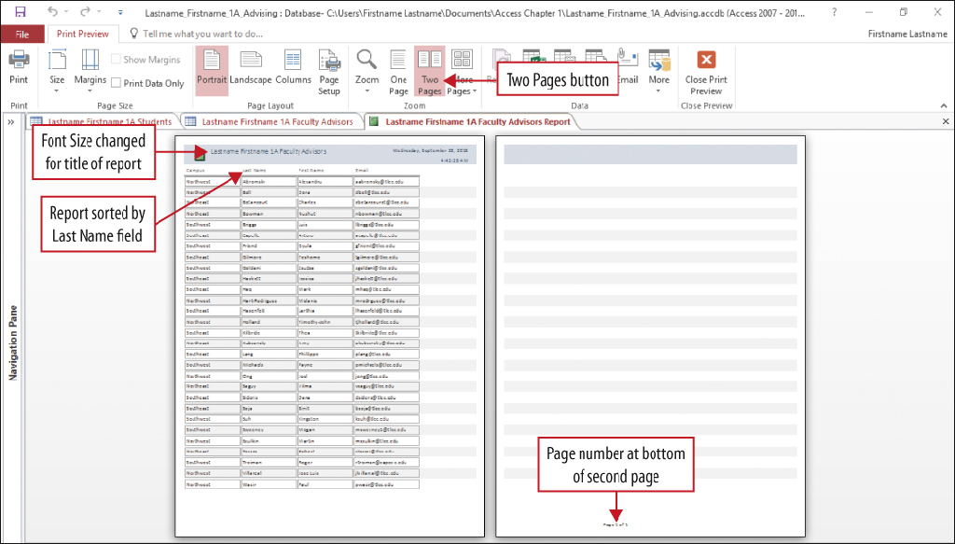
Create a Query, Form, and Report
Layout View of the Table
Print Preview of the Report
Notes:
A report is an object that displays all the information from a table in an easy-to-read format which is suitable for printing. Reports can be created to summarize information.
The report layout view is very similar to the layout view of a form. Layout view is where changes to the report or form format can be made.

Slide 19
Close a Database and Close Access
Notes:
When closing a table, changes made to records are saved automatically. Changes to structure or adjusted column widths require saving the object again. If the navigation pane is open, all the objects created will be listed.
When finished using the database, close the database objects, and exit Access.

Slide 20
Use a Template to Create a Database
Notes:
A database template has prebuilt tables, queries, forms, and reports that can be modified to suite your needs. The advantage of using a template is that you do not have to create the objects, you just need to modify them.
There are two types of templates, one stored on your computer and the other one designed to be shared with others over the Internet.
To store a database on your desktop, select the Desktop task management template. To publish the template on the Internet to be shared with others, choose the Task management template with the globe image.

Slide 21
Use a Template to Create a Database
Notes:
A single-record form enables you to display or enter one record at a time into the table. Many times it is easier to key information into a form rather than a table.

Slide 22
Organize Objects in the Navigation Pane
Notes:
The Navigation Pane groups and displays your objects in a predefined arrangement. The Tables and Related Views category groups objects by the table they are related to. This grouping is helpful because you can easily see which queries, forms, or reports were created for a particular table. If a query, form, or report was created by using more than one table, each table group will display that object.

Slide 23
Create a New Table in a Database Created with a Template
Notes:
Redundant information in database tables is not good database design. Because the data is duplicated, it is too easy to miss changes and key inaccurate information. When there is redundant information, it is a sign that a new table should be created. To create a new table, click Table in the Tables group on the Create tab.

Slide 24
Print a Report and a Table
Notes:
Professional looking reports can be created, formatted, and printed. It is a good policy to use Print Preview to determine whether the table or report will print all the information accurately or if adjustments should be made.

Slide 25
Summary
A database is a collection of data
Databases can be created from scratch, by using a template, or a custom web app template
Define data types and name the fields before entering records
Tables, Forms, Queries, and Reports are objects used in Access
Notes:
A database is a collection of data which is facts about people, events, things, or ideas.
Databases can be created from scratch by using the blank desktop database, a template that contains prebuilt tables, queries, forms, and reports, or a custom web app template.
Before entering records in a table, which is the foundation of a database, you must define data types and name the fields. Common data types are Short Text, Currency, Number, and Date/Time.
Forms can be used to enter data into a table or view the data in a table. Queries are used to retrieve specific information from tables, and reports display information from tables in a professional-looking format.

Slide 26
Questions ?

Slide 27
Copyright
All rights reserved. No part of this publication may be reproduced, stored in a retrieval system, or transmitted, in any form or by any means, electronic, mechanical, photocopying, recording, or otherwise, without the prior written permission of the publisher. Printed in the United States of America.

